Slide 1

Minnesota’s Water Resource Management
Minnesota Legislature: House Water Division
January 14, 2019

Slide 2
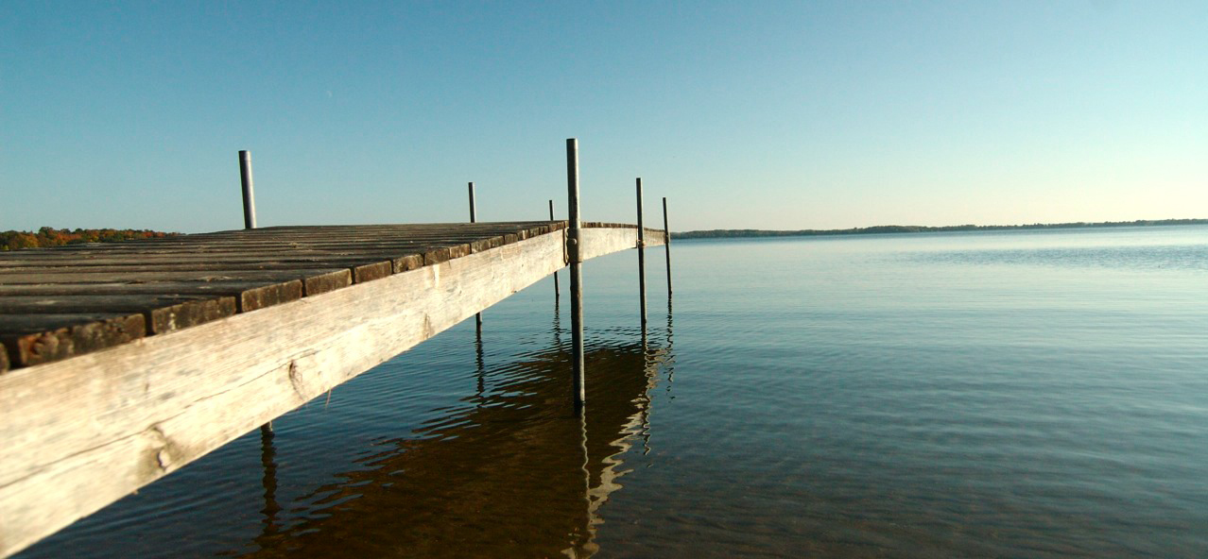
Minnesota Water Agencies
MN Pollution Control Agency
Board of Water and Soil Resources
MN Department of Natural Resources
MN Department of Agriculture
MN Department of Health
Public Facilities Authority
Metropolitan Council
Environmental Quality Board

Slide 3
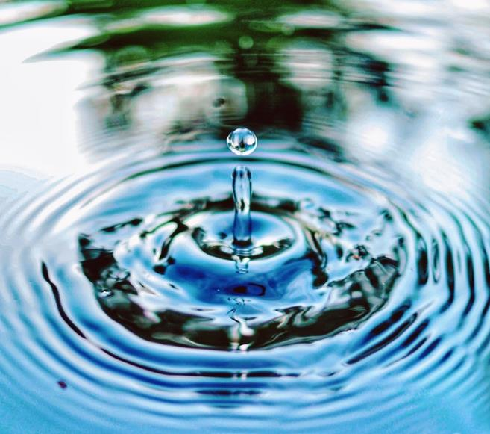
Water Resource Management – A statewide effort
Water is central to the core mission of many state agencies.
Minnesota Water Management Framework ensures work is coordinated across agencies and with local water management.
Goals: Clean and sustainable water
Notes:
PAIR WITH HANDOUT OF WATER MANAGEMENT FRAMEWORK
Water is central to the core of the mission of many state agencies therefore there are water programs in many agencies. These agencies work together to ensure the state has a comprehensive approach to water issues to ensure
Department of Agriculture
Metropolitan Council
Minnesota Board of Water and Soil Resources
Minnesota Department of Health
Minnesota Pollution Control Agency
Public Facilities Authority
Each agency
DNR – conserving natural resources, providing outdoor recreation and providing commercial use of natural resources in ways to sustain quality of life

Slide 4
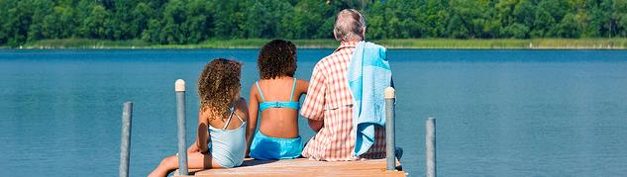
Minnesota Pollution Control Agency
Shannon Lotthammer | Assistant Commissioner

Slide 5
MPCA Water Jurisdictions/Authorities
Federal Clean Water Act – state implementing agency
Key Minnesota Statutes – water quality focus
  Chapter 115 -- Water Pollution Control
  Chapter 116 -- Pollution Control Agency
  Chapter 114D -- Clean Water Legacy Act
  Chapter 103H -- Groundwater Protection Act (also Chapter 103A)
Notes:
Water Pollution Control (including standards, wastewater,
Groundwater Protection Act (103H) – pollutants other than agricultural chemicals

Slide 6
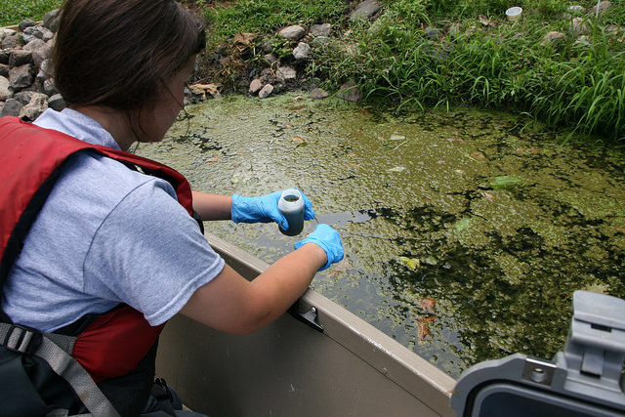
Surface Water: Monitoring and Analysis
Monitor and assess all 80 watersheds in MN
Create a baseline for measuring progress
Identify existing uses and set water quality standards
Provide data and info to citizens, businesses, communities, stakeholders
Notes:
Direct members to the Handout of progress on monitoring of 80 watersheds.
Per 2006 legislation and the 2008 constitutional amendment that created the Clean Water Legacy Fund, and dollars from that fund, we are monitoring and assessing all 80 watersheds in MN.
The Idea: Monitor to establish a baseline – do implementation on the land at BWSR and elsewhere – come back in 10 years to measure progress. Repeat.
Handout: In your handouts is a map showing our progress on the first 10 year cycle.
This program is undertaking the first-ever effort to intensively monitor and assess all 80 of Minnesota’s watersheds, thanks to funding provided by the Clean Water Legacy Fund. A 10-year process set in statute, the program has completed 54 watersheds thus far and will have all 80 watersheds completed by the end of calendar 2017. This program monitors and assesses Minnesota’s surface water resources to determine if standards are being met, identifies the existing uses of Minnesota’s water resources, sets water quality (WQ) standards and investigates contaminants of emerging concern (CEC) to evaluate risks and to inform policy and management decisions. As detection technology rapidly advances and the availability of scientific information accelerates, there are pressures to identify new water quality standards (i.e. wild rice, phosphorus) and update existing ones (chloride). This program uses a triennial review process to determine sequencing and prioritization for updating water quality standards. Citizens, stakeholders and legislators use this program’s work and the information produced to better understand the presence, extent, impacts and management options for pollutants/contaminants in our surface waters.

Slide 7

Watersheds: Grants, Strategies
Work with local partners to lay out options for protecting and restoring waters in their watershed
WRAPs = Watershed Restoration and Protection Strategies
WRAPs inform BWSR’s “One Watershed, One Plan”
Notes:
Photo: Whitewater River watershed project water quality summit in the Mississippi R-Winona watershed

Slide 8
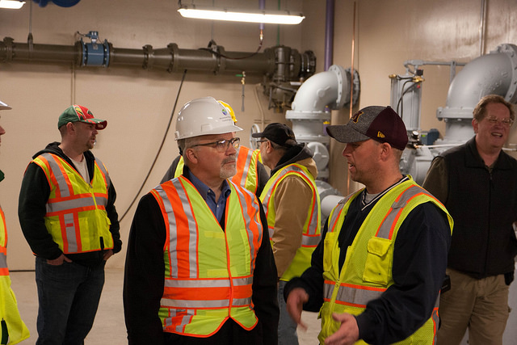
Surface Water: Wastewater treatment facilities
Issue permits to wastewater treatment plants
Provide technical assistance, operator training and certification
Work with Public Facilities Authority on loans/grants to cities for upgrades
  A key concern is aged-out wastewater infrastructure
Notes:
Photo: MPCA staff, including Commissioner Stine, toured the St. Francis wastewater treatment facility. The city made the decision to build a new $24 million facility in anticipation of bonding funds from the state.

Slide 9
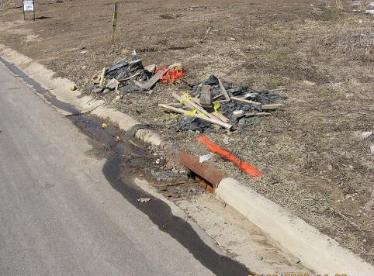
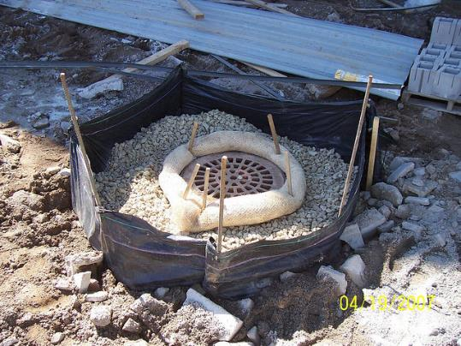
Surface Water: Stormwater management
Permitting, technical assistance, and compliance and enforcement to prevent pollution
  Construction stormwater permits required when more than 1 acre is disturbed
  Industrial stormwater permits for industrial facilities
  Municipal separate storm sewer systems, or MS4, permit for storm sewers owned by cities, townships, counties, prisons and colleges
Notes:
The stormwater program prevents pollutant runoff and excess water volumes from degrading water quality in lakes, rivers and streams. Permits requiring pollution prevention plans/measures are issued by this program for construction sites, municipalities and industrial sites. This includes about 3,415 industrial stormwater permits, and an average of 1,710 construction stormwater permits per year. Any site disturbing more than one acre of land requires a construction stormwater permit. Regulated municipal storm sewer systems owned by cities, townships, counties, prisons and colleges must obtain a Municipal Separate Storm Sewer Systems, or MS4, permit through this program.
Photos: Top – what not to do.
Bottom – good stormwater management
Construction site managers must use stormwater inlet protection to trap sediment before it enters a storm sewer. This will keep sediment out of lakes and streams and can also prevent clogging of the storm sewer by heavy sediment loads.

Slide 10
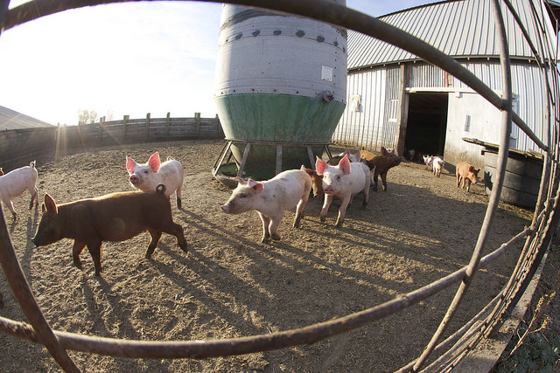
Surface Water: Feedlots
MPCA and counties cooperatively regulate Minnesota’s 18,000 feedlots
Ensure manure does not run into surface water from feedlots or storage areas; Prevent contamination from manure applications
52 counties are delegated to do this work in their county
MPCA handles remaining 35 counties with technical assistance to farmers, inspections at farm operations.
About 1,100 feedlots are >1000 AU
Notes:
This program regulates some 24,000 registered livestock feedlots statewide, of which about 1,100 are >1,000 animal units, working with 53 delegated counties to issue and enforce water permits (National Pollutant Discharge Elimination, or NPDES, and/or State Disposal System, or SDS, permits).

Slide 11
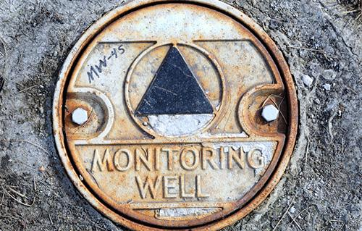
Groundwater: Monitoring
Provide data on Minnesota’s groundwater quality
  From a network of 269 monitoring wells
Analyze and understand quality so we can better protect groundwater from contamination
Gauge effectiveness of land use practices and BMPs to reduce pollution
Collaborate with the public and private sector by providing data and technical assistance
Notes:
MPCA covers groundwater and non-ag chemicals or pollutants – MDA handles spills and contamination from ag-related chemicals
This was established under the 1989 Groundwater Protection Act. MPCA focused on ambient – non-spill impacted.

Slide 12
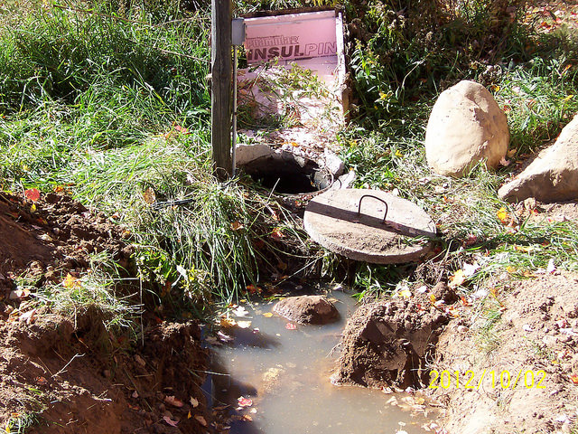
Groundwater: Septic systems
Prevent groundwater pollution by working with counties and cities to manage septics in unsewered areas of Minnesota
Both single family home and larger septic systems (resorts, subdivisions)
Work with systems that generate volumes less than 10,000 gallons per day
Notes:
Photo: Example of old, failing septic
Subsurface Sewage Treatment Systems = SSTS

Slide 13
Groundwater and Surface Water
Emergency Response program
Superfund
Closed Landfill Program
Hazardous Waste Program
Petroleum cleanup program
Solid waste program
Underground and above ground storage tanks
These programs all protect groundwater and surface water either by
PREVENTING contamination or by CLEANING UP past contamination

Slide 14

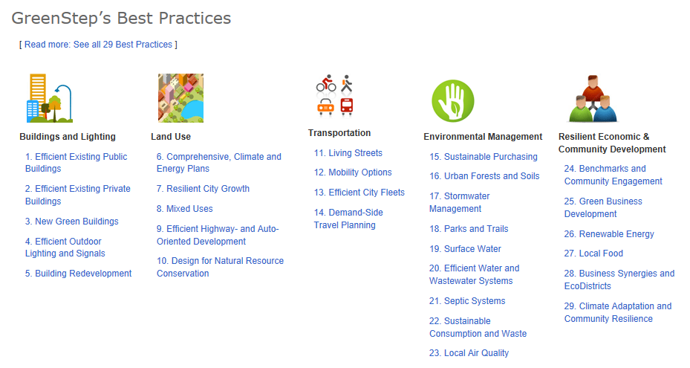
Pollution Prevention and Community Assistance
“Front-end” efforts to decrease costs, risks, and environmental concerns by reducing or eliminating waste and pollution at its source
  Example: Minnesota Technical Assistance program
Community Assistance
  Example: GreenStep Cities

Slide 15
MPCA Clean Water Fund activities
MPCA activities focus on monitoring and assessment, strategy development (including total maximum daily load studies), and point source implementation
FY18-19 appropriation: $49.33m to MPCA
FY20-21 CWC recommendations: $46.89m to MPCA
Reduction for FY20-21 primarily reflects reduced planning efforts as WRAPS are being completed

Slide 16
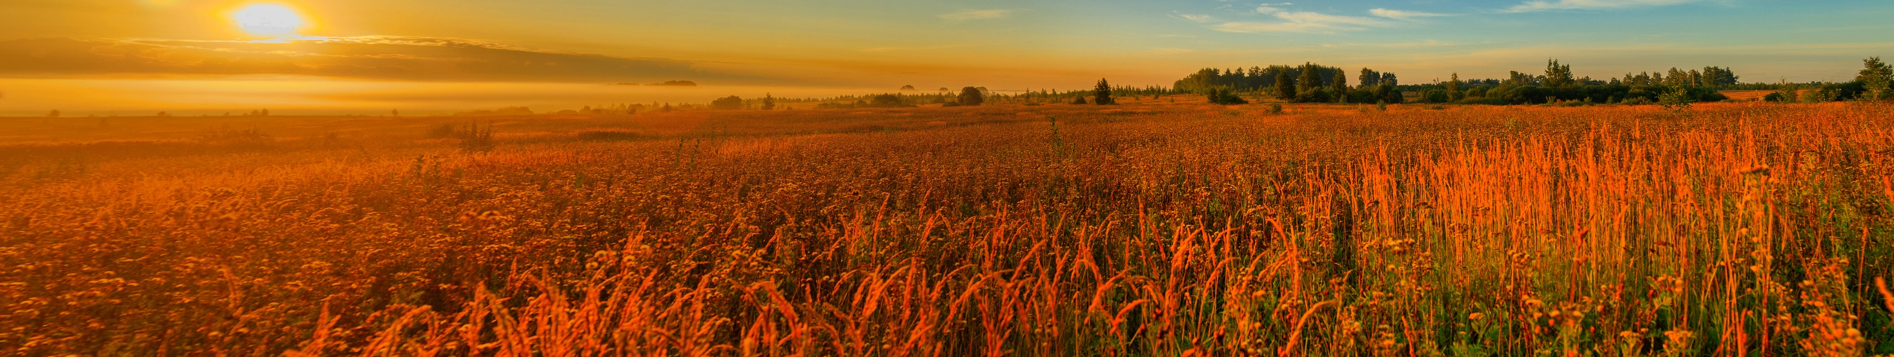
Board of Water and Soil Resources
Angie Becker Kudelka| Assistant Director

Slide 17
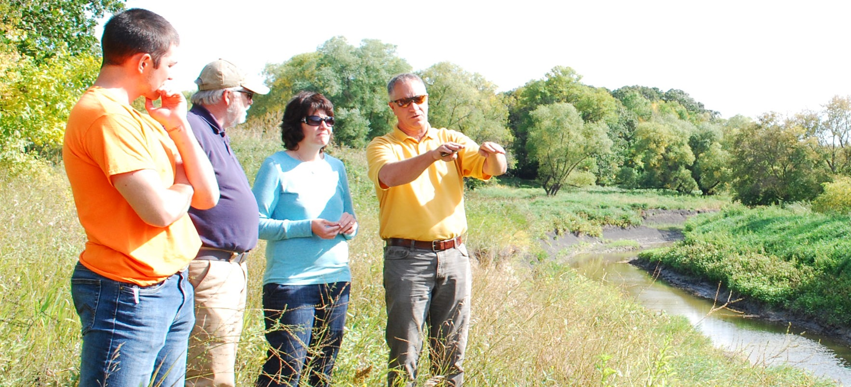
BWSR’s mission
Improve and protect Minnesota’s water and soil resources by working in partnership with local organizations and private landowners.

Slide 18
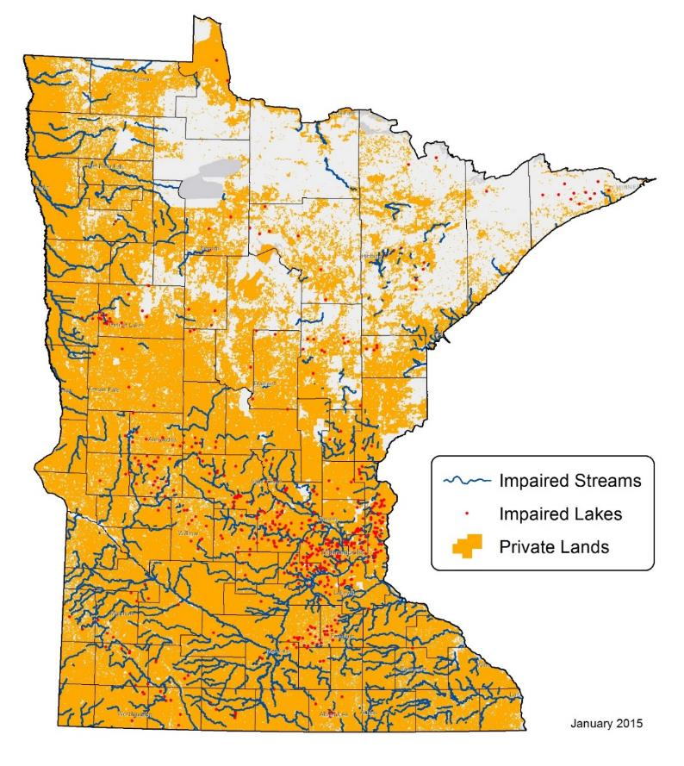
Business model
Private lands
Local government delivery system
On-the-ground results

Slide 19
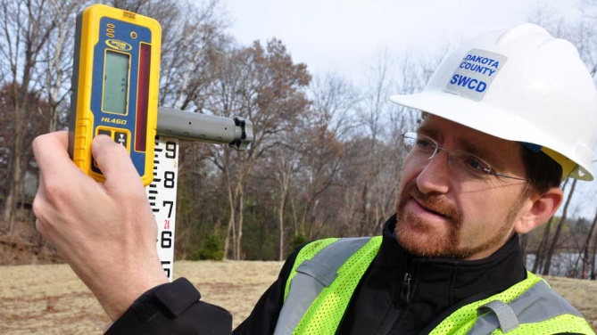
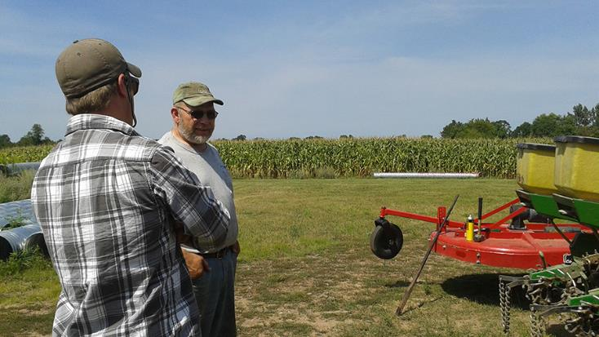
Statutory Authorities
Water Planning and Conservation Delivery
Minn. Stat. 103

Slide 20
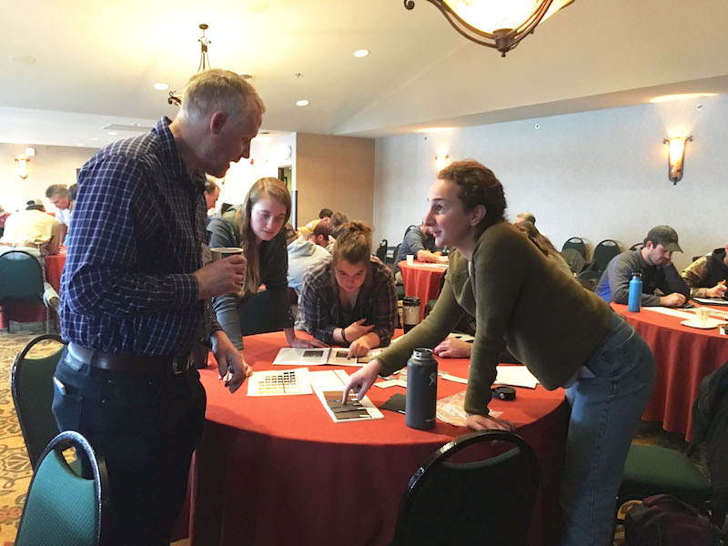
Statutory Authorities
Soil and Water Conservation District and Watershed District Oversight and Accountability
Minn. Stat. 103

Slide 21
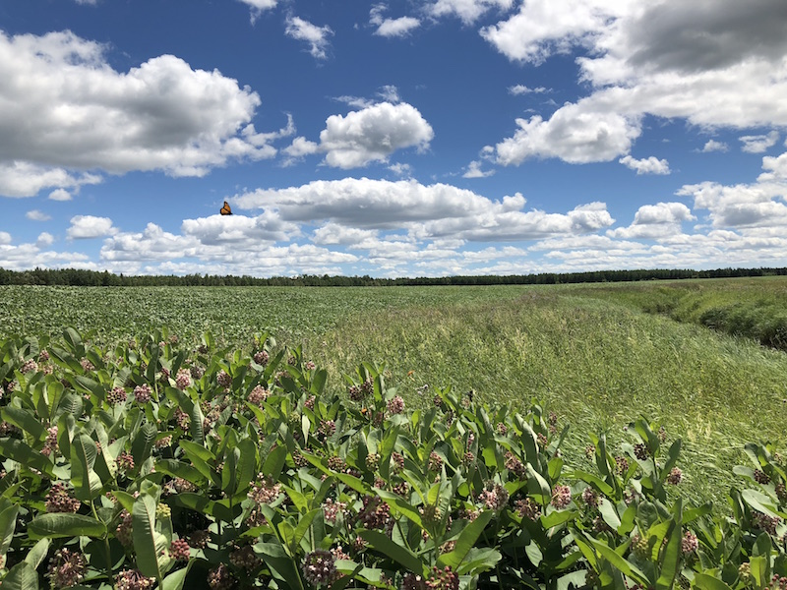
Statutory Authorities
Regulatory
Wetland Conservation Act
Drainage
Buffers
Minn. Stat. 103

Slide 22
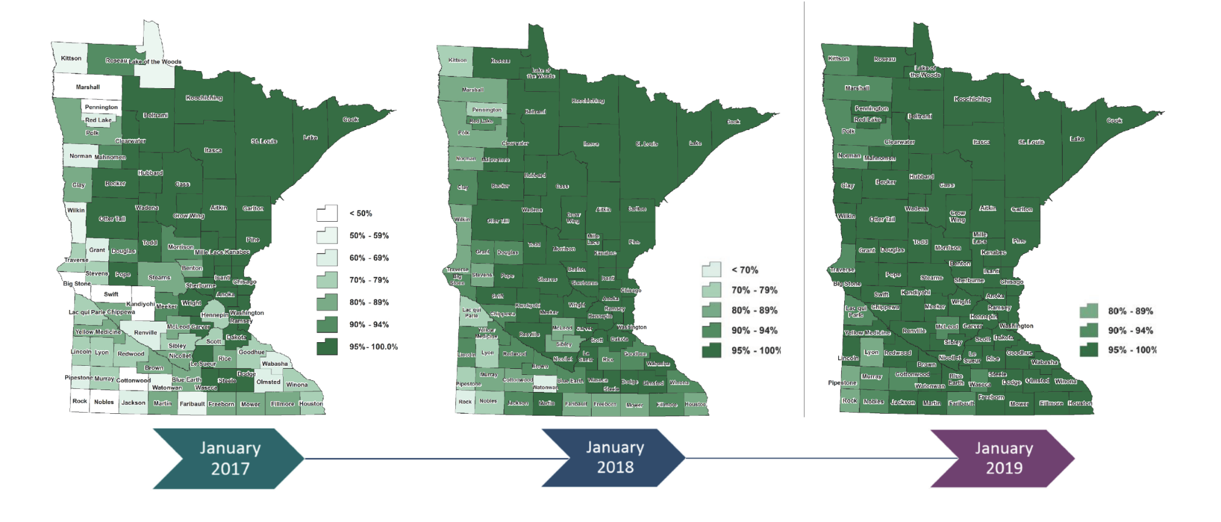
Public Waters Estimated Compliance

Slide 23
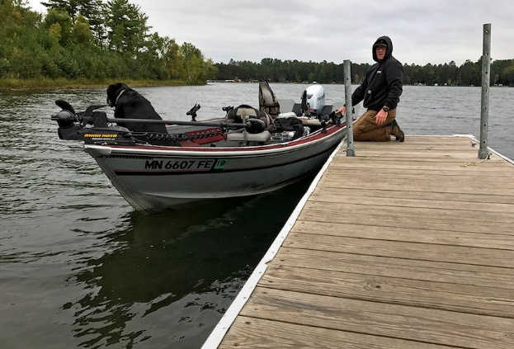
Statutory Authorities
Clean Water Legacy Act
Minn. Stat. 114

Slide 24
The Conservation Continuum
Landowner choices:
No outside support |  | Technical Assistance |  | Contracts |  | Short-term land retirement |  | Perpetual land retirement

Slide 25
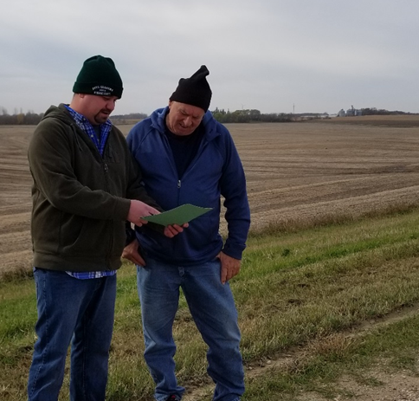

Voluntary Resource Protection
“It’s a good opportunity to get a fair payment on ground that would be idle and to do your part for resource protection.”
Minn. Stat. 103
Notes:
To date:
6,581 easements permanently protecting 290,543 acres

Slide 26
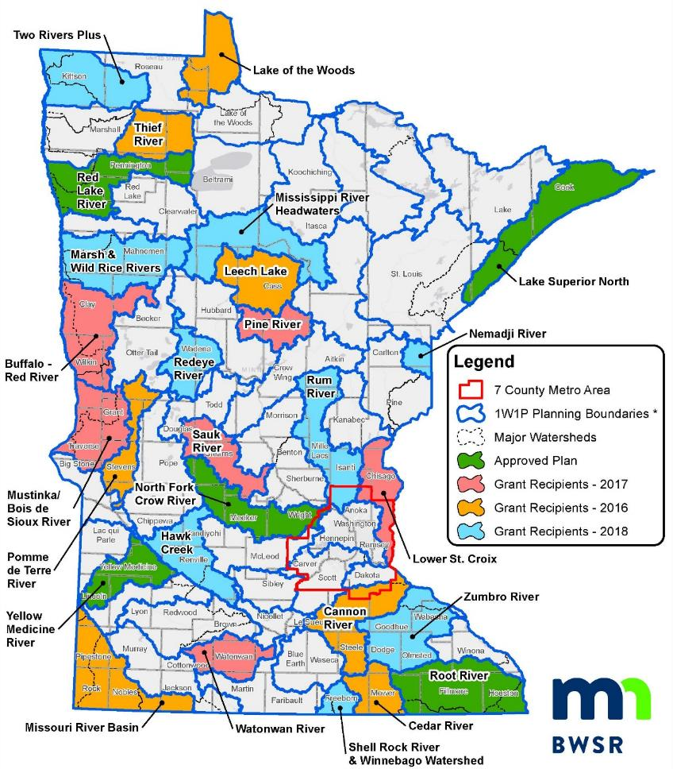
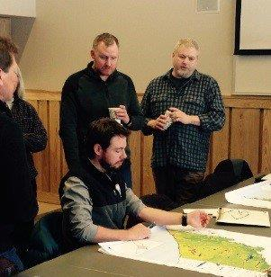
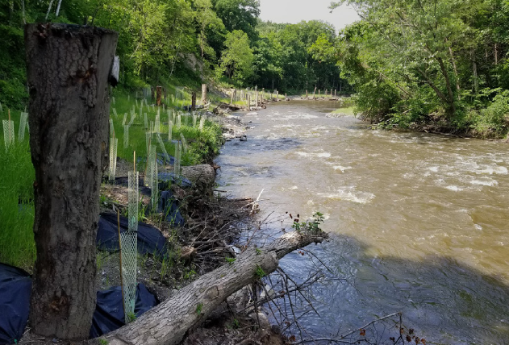
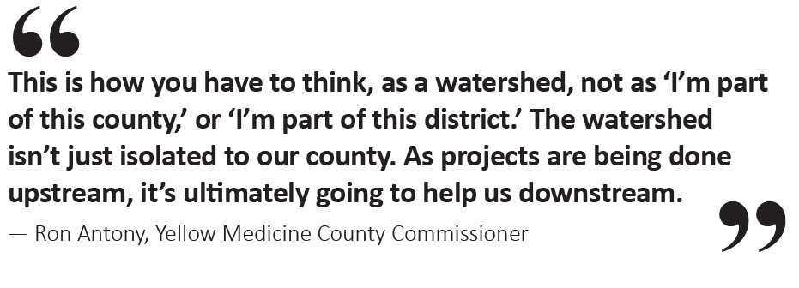
Local Water Management
Minn. Stat. 103

Slide 27
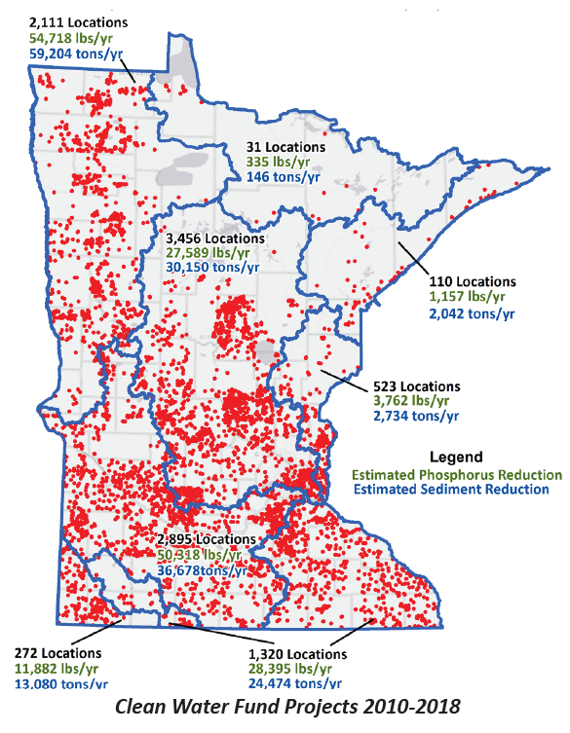
Conservation Implementation
1,615 Clean Water Fund grants
7,000 conservation practices.
168,500 tons of sediment annually
178,150 pounds of phosphorus annually

Slide 28
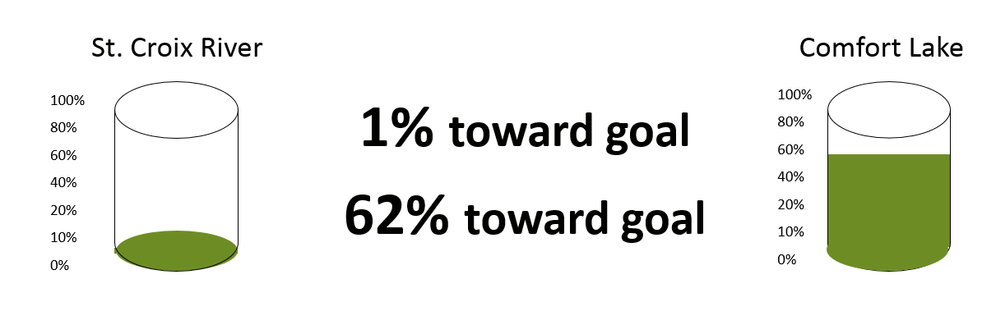
Progress toward goal

Slide 29
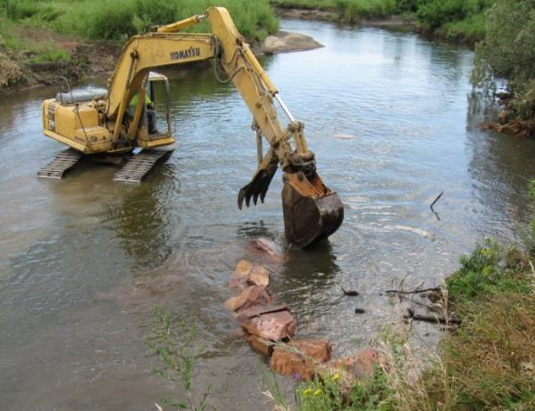
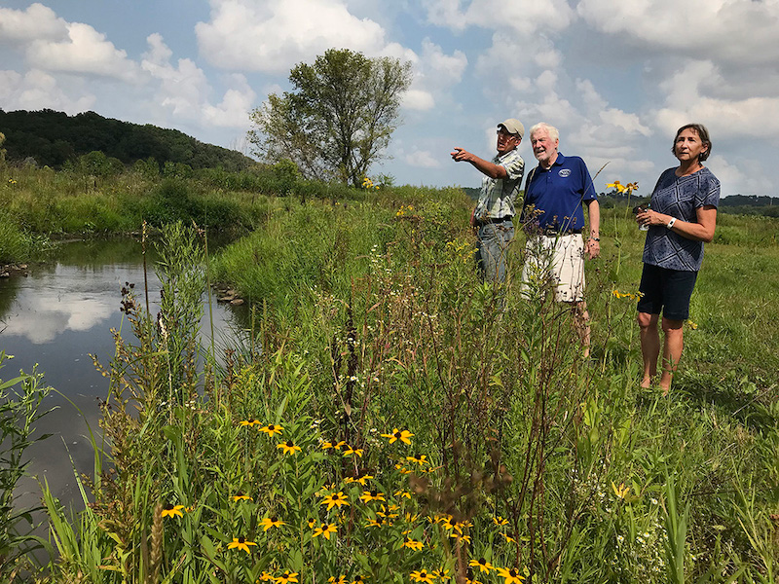
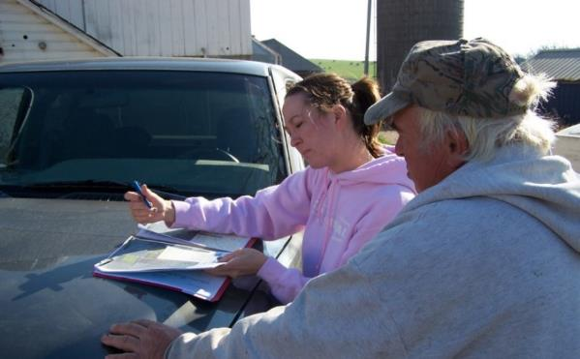
On-the-ground conservation

Slide 30
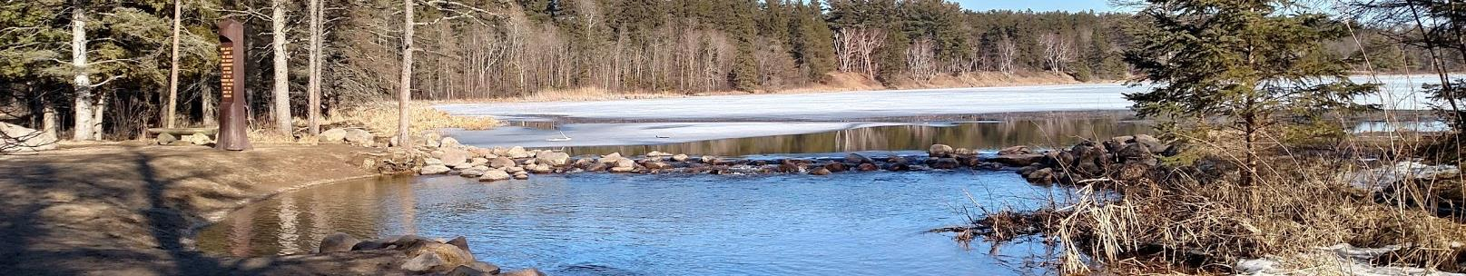
Minnesota Department of Natural Resources
Jason Moeckel | Inventory, Monitoring and Analysis Section Manager

Slide 31
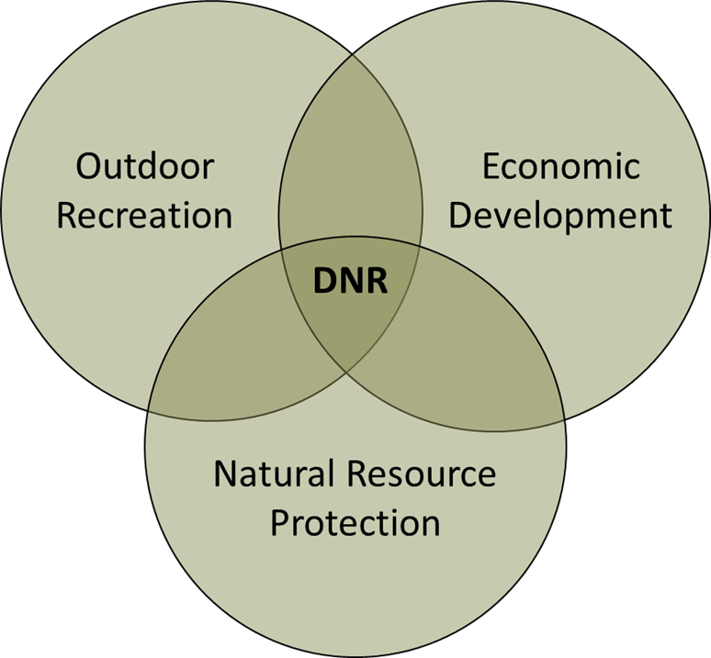
DNR’s Mission
The mission of the Minnesota Department of Natural Resources is to work with citizens to conserve and manage the state’s natural resources, to provide outdoor recreation opportunities, and to provide for commercial uses of natural resources in a way that creates a sustainable way of life.
Notes:
DNR – Clean and sustainable water is integral to the DNR mission.
Conservation of waters so citizens can enjoy the outdoors and benefit from natural resources
Promote responsible use of water resources for our collective economic benefit
Protect and promote healthy ground water

Slide 32
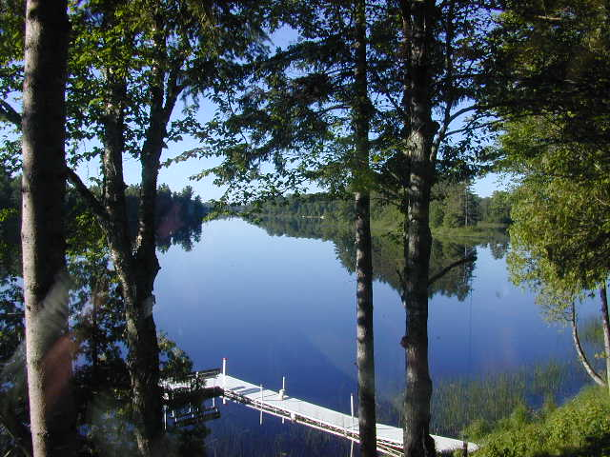
DNR’s Water Management Responsibilities
Statewide Water Information System - 103A
Sustainable Use of Water -103G
Floodplains and Shoreland– 103F
Wild and Scenic Rivers – 103F
Public Waters – 103G
Public Safety (Dams) – 103G
Aquatic Invasive Species – 84D
Notes:
EWR is the division where the majority of water management occurs and will be the focus of our overview today. (Primary programs listed on the slide)
Brief overview and the statutory reference, will talk about each of these in a bit more detail.
103A.401 – DNR in cooperation w/ state agencies and the MGS shall establish and maintain a statewide water information system on the availability, distribution, quality, and use of waters….
103G – The section of statute is about the sustainable use of water, it provides direction to the DNR for authorization of water use through a permit program, when use will exceed 10,000 gallons a day or 1 million gallons a year.
103F – floodplain ordinances, flood hazard mitigation, flood hazard insurance
Shoreland development standards – preserve the economic and natural values, wise use
Wild and Scenic Rivers include standards for development to protect those values
103G – includes the public waters protection program, includes direction regarding the types of activities that can be permitted, this section covers drainage, wetland conservation, work in public waters such as excavation, boat houses and other structures.
However, all divisions within our agency do significant water-related work:
LAM – mining-related water permitting
ENF – enforces natural resource laws like WCA, public waters & appropriations
FOR – forest stewardship plans, riparian management of timber harvests
PAT – wastewater treatment at park facilities, management of aquatic features at state parks, boat and water safety
FAW – Land management through AMAs, WMAs, wetlands, stream restorations
Supplemental:
FAW Wildlife Management Areas (WMA), contribute to both surface and ground water quality enhancement through fee title acquisition from willing sellers and through our habitat restoration program.
Marginal lands that contain converted wetlands and grasslands are targeted for land acquisition. Once acquired, converted wetlands and grassland on these newly acquired WMA’s are restored and provide ecosystem services (i.e. water quality enhancement, flood retention, carbon sequestration, etc.), as well as providing wildlife habitat for wildlife and recreational opportunities for the visiting public.
FAW Aquatic Management Areas (AMA), contribute to the protection of high quality deep water lakes (i.e. cisco lakes), through a voluntary “working lands” and conservation easement programs with private landowners. Vegetative cover is protected in these watersheds resulting in cleaner water delivered to these lakes and healthier fish populations.
Could include some financial information or leave it out for this introduction.
$40 million – three funds – General Fund, Water Management Account, Clean Water Fund (pie charts on subsequent slides if needed)
directed by rider or stated,
also bonding for FDR,
federal funding for a variety of water management activities and a little bit of Water Rec for land use and environmental review
Water funds dedicated solely to clean water and sustainability activities through rider or statute.
EWR overall:
-Ensures the long-term health of watersheds that support water quality and maintain water availability, biodiversity, and vital ecosystem services
-Provides critical information and regulatory oversight to state and local governments and landowners to foster natural resources stewardship, dam safety

Slide 33
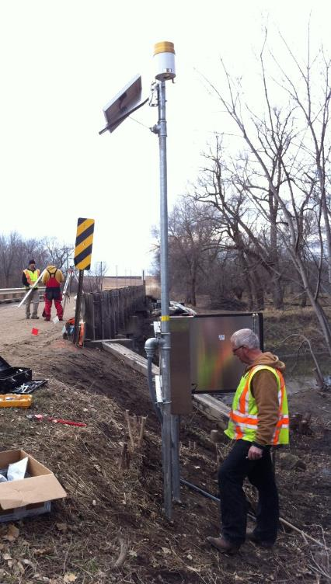
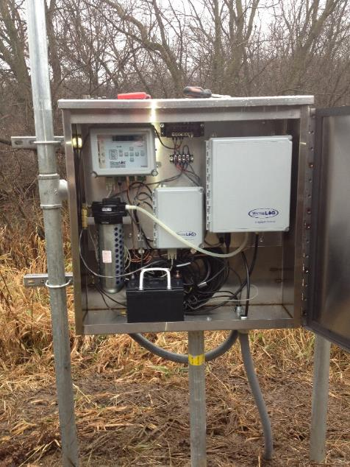
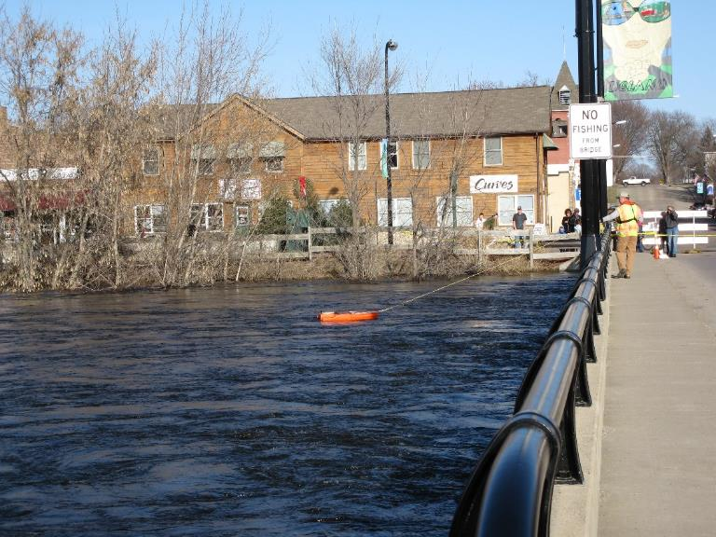
Statewide Information Systems
Measuring streamflow at flood stage
Electronic equipment used to measure and record data
Installing a new stream gauge
Notes:
Over 2,800 sites monitored for groundwater, streamflow, precipitation and lake levels, providing baseline data for trends & better information for permitting.
The monitoring data DNR collects forms the basis of flood stage analysis, flood warning systems, low flow management during droughts, appropriation permit decisions and other water management decisions. All of these data are published through the DNR’s website.
Who benefits?
State, federal, local governments
Permit applicants
Water users
Where do funds come from?
General Fund
Water Management Account
Clean Water Fund
How it relates to statewide efforts
Projects, plans and permits benefit from high quality baseline data

Slide 34
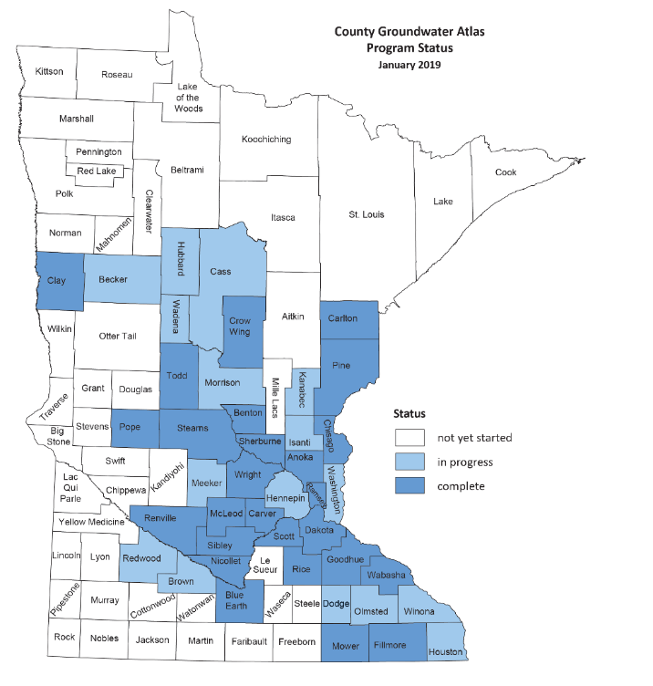
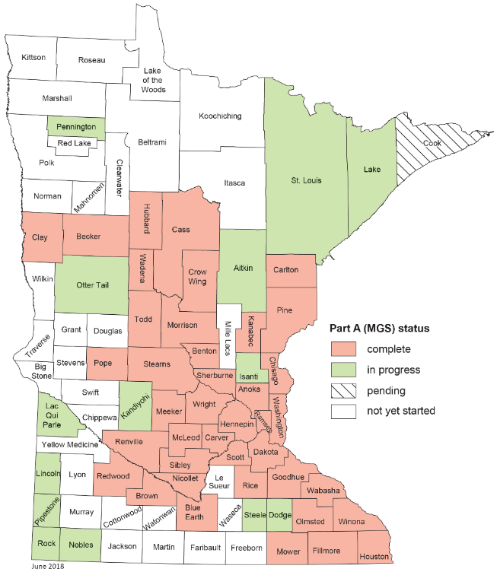
Statewide Information Systems - County Geologic Atlas
Notes:
To say that Minnesota’s Geology is complex and variable would be an understatement. County Geologic Atlases provide essential information about the geologic materials and how water is stored and moving through this complex mosaic.
Atlases are developed by the Minnesota Geological Survey (housed at the U of M and the DNR). MGS completes Part A the geology. DNR completes part B the hydrogeology.
Atlases

Slide 35
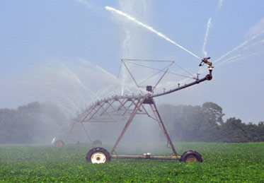
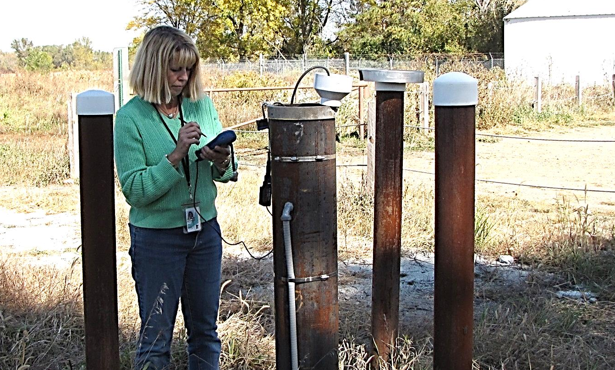
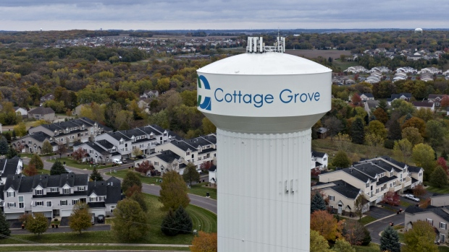
Sustainable Use of Water
Notes:
Groundwater is the drinking water source for 75% of Minnesotans
Groundwater has become critical for an increasing number of agricultural producers
Groundwater is vital to many of our fish and wildlife species and our recreational economy
DNR’s Primary Functions related to Groundwater
Determine how much we have and where it is.
Determine how much we can reliably use
Help individuals and communities to protect and maintain our groundwater
We accomplish these functions through a combination of monitoring and analysis, developing County Geologic Atlases, education, regulation and management, and consultation and technical guidance
A few accomplishments
26 County Geologic Atlases completed
1,052 groundwater monitoring wells.
In FY 2017 we issued 726 appropriation permits/amendments
Who benefits?
Communities
Permit holders
Water users
Where do funds come from?
General Fund
Water Management Account
Clean Water Fund
How it relates to statewide efforts
GW restoration & protection strategies
Community assistance

Slide 36
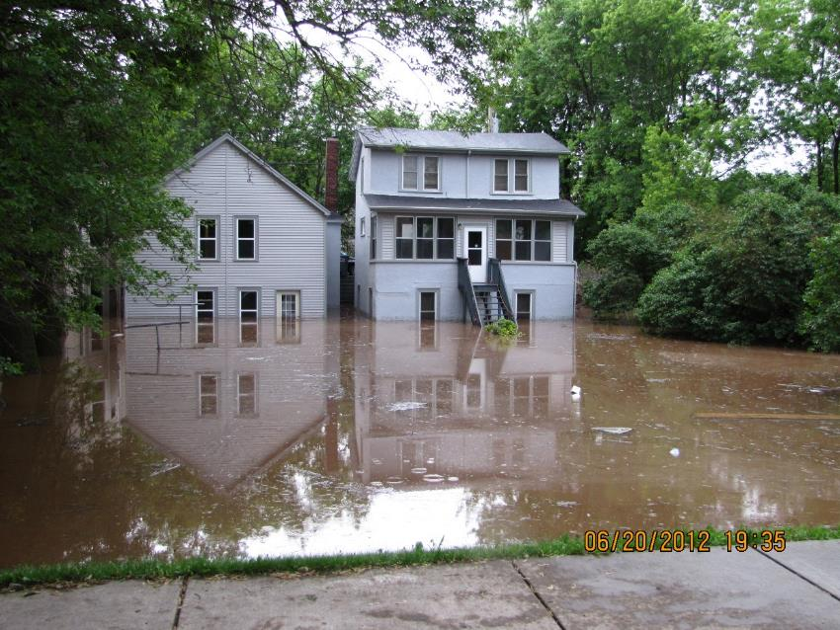
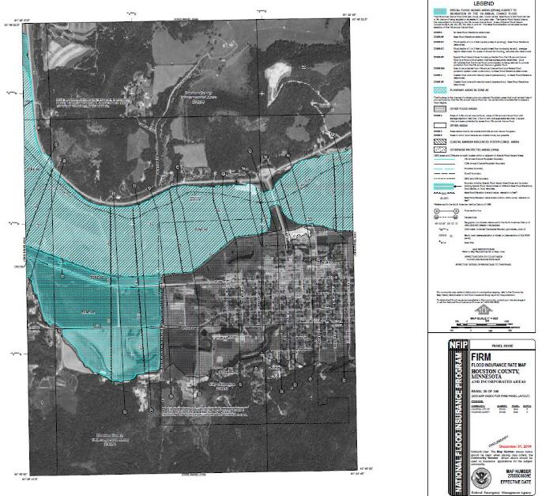
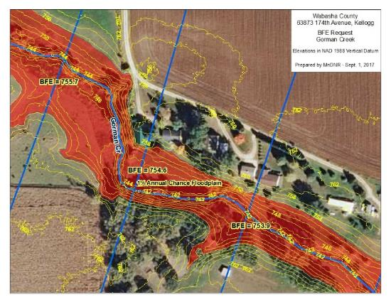
Public Safety & Floodplains
Digitized Flood Insurance Rate Map (DFIRM) example
Base Flood Elevation (BFE) data for City of Gorman
Flooding in a Duluth neighborhood
(photo credit: Chris Kleist, City of Duluth)
Notes:
DNR works to break the cycle of flood damage and repair.
Key messages:
Provide technical and financial assistance to LGUs for reducing the damaging effects of floods.
Provide information and links to resources for landowners and local governments.
Provide training and education for floodplain administrators.
Help communities qualify for the National Flood Insurance Program.
Outcomes:
Through cost share grants, more than 2,800 buildings have been removed from floodplains.
About 50 Community Assistance Contacts per year (these are a quick check in on the status of ordinances, maps, known violations/problems) & about 4 Community Assistance Visits (more formal--review permits/records/process)
At least 10 trainings + additional shorter ones per year
Interpretations of ordinances & law
Assistance with determining base flood elevations
Help with map changes
FEMA map modernization—we work to get the best available data from counties/LGUs; since 2015 nine counties have new FEMA maps & we are working on getting better data in 15 counties (we’re doing modeling for 8 of them; we do the outreach (kickoff meeting, get available data & model; flood risk review meeting; training—county picks topics). During past couple years, with cost sharing grant from FEMA, we’ve really ramped up.
Who benefits?
Local governments
Citizens living in floodplains
Where do funds come from?
General Fund
Federal (FEMA)
Bonding
How it relates to statewide efforts
Local water planning
More information on the photos:
Photo of flooding in a Duluth neighborhood. This photo was taken in 2012 by Chris Kleist, City of Duluth. He has given us permission to use it.
A DFIRM example for the City of Houston. The DNR did the hydraulic modeling and floodplain delineations for Houston County. After submitting our data to FEMA’s contractor, DFIRM panels are created. Pertinent information shown includes:
The 1% and 0.2 % (100-Yr and 500-yr) floodplain boundaries
Floodway boundary
Cross section locations used in the analysis
Base flood elevation lines (BFEs)
A map of a recent BFE request from Bill Huber for the City of Gorman. The data came from work we did for FEMA. Although DFIRM panels have not been developed yet, we can provide this data to local governments as best available data.

Slide 37
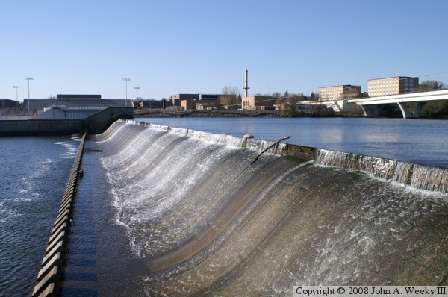
Public Safety (Dams)
Public Safety is Job 1
1,250 Public and Private
Majority > 50 years old
Authorization, Inspection, Repair
Notes:
Through bonding – DNR spends ~ $1M annually on repairs and reconstruction
Estimated $114M needed over the next 20 years to assure public dams remain in a safe and usable condition

Slide 38
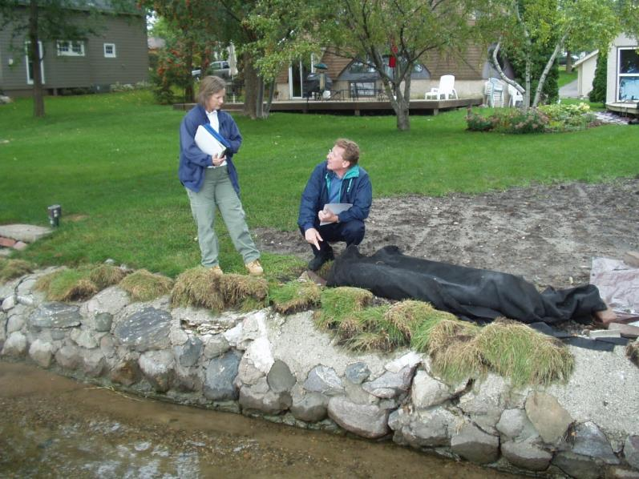
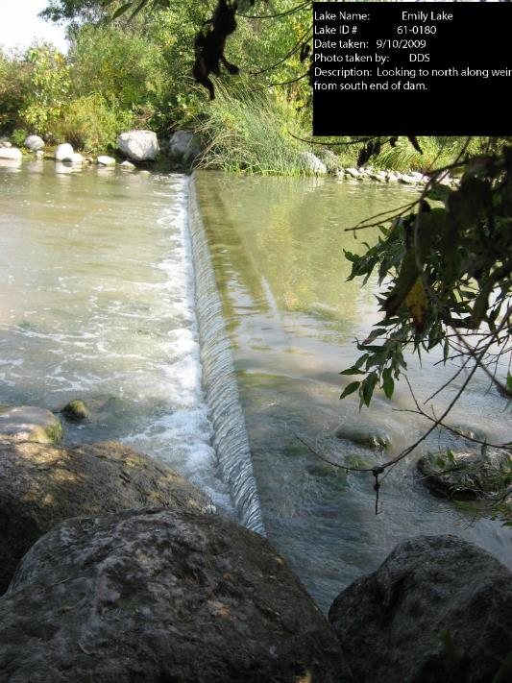
Public Waters - Protection
Water level control structure on Emily Lake in Pope County
DNR staff member discusses shoreline erosion control project with homeowner
Notes:
What do we do? -- Regulate changes to public waters; Provide technical guidance.
Work to protect surface water resources is primarily carried out by Area Hydrologists by:
processing work in the beds permits,
conducting Ordinary High Water Elevation surveys,
performing field inspections to assist riparian owners with compliance with the permit program rules,
assisting with dam safety inspections,
responding to floods and droughts and
addressing lake level and lake outlet concerns.
What is the result?
Projects that impact public waters are constructed in accordance with state water law
747 public waters permits/amendments FY17
Who benefits?
Landowners whose property is adjacent to a public water—Area Hydrologists work with project proposers to ensure the project could go forward in a way that minimizes the impacts to public waters.
Water resources are protected for the benefit of all citizens
Local governments
Where do funds come from?
General Fund
Water Management Account: (Issue--Public water permit fees do not support the public waters permit program. Within the Water Management Account, the water appropriation fees are used to subsidize the work in public waters permit program.)
Water Recreation Account
How it relates to statewide efforts
Restoration/WQ projects needing permits
Permits are tracked/mapped allowing for cumulative impact analyses

Slide 39
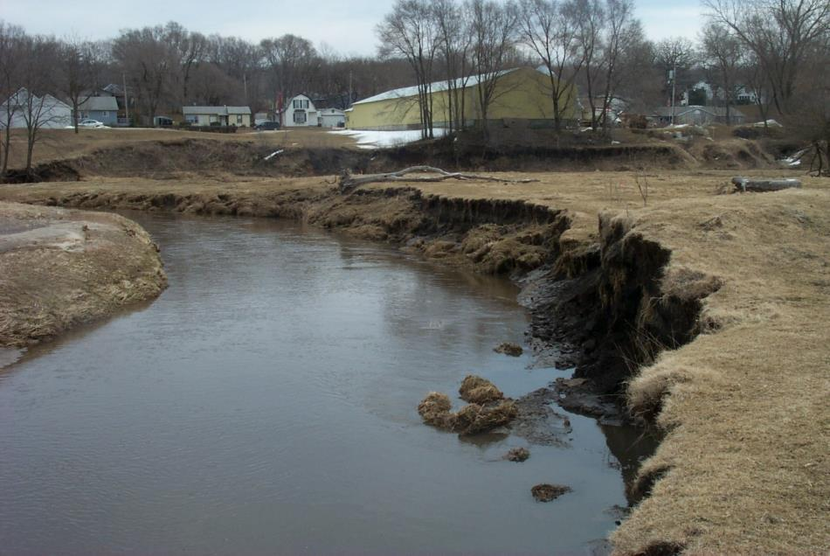
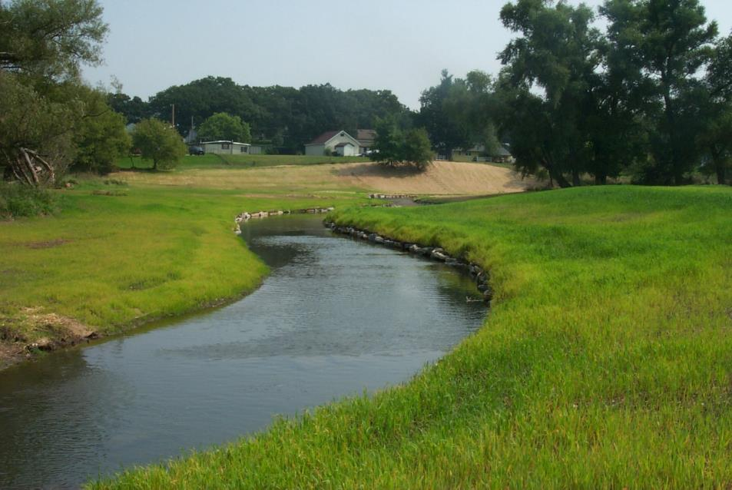
Public Waters - Restoring Stream Health
Mill Creek, Chatfield, MN
From Degraded, Poor Habitat ⇨ Improved Water Quality, Habitat, and Recreation
Notes:
Excess sediment is the leading cause of impairments across Minnesota Streams and Rivers and streambank erosion is the largest cause of excess sediment.
DNR collects data to identify which watersheds and streams are contributing the largest sediment loads. DNR works with local partners, providing technical guidance and some funding to implement projects like the one shown on this slide. These projects restore stream functions while improving both water quality and habitat for fish and wildlife.
Many of these projects also protect human infrastructure like businesses and homes shown in the background.
What do we do?
Guidance on restoration design
Fund projects
What is the result?
9 restoration projects 2017
Who benefits?
MN citizens
Resource users
Where do funds come from
Game & Fish Fund
Clean Water Fund
Outdoor Heritage Fund
Bonding
How it relates to statewide efforts
Better water quality, heavy contribution into WRAPS, 1W1P

Slide 40
Funding Sources FY18-19
CWF – Supporting Role
Data Collection, Analysis and Technical Assistance
  Targeting
  Project planning
  Project design
  Project implementation
Notes:
This pie chart shows the major DNR appropriations and amounts in Millions.
As described earlier there are other funding sources that indirectly support water management activities, including the Water Rec account, G&F Fun
Working with other agencies, local governments and conservation organizations to ensure the long-term health of watersheds that support water quality and maintain water availability, biodiversity, and vital ecosystem services
-
Provides critical information and regulatory oversight to state and local governments and landowners to foster natural resources stewardship

Slide 41
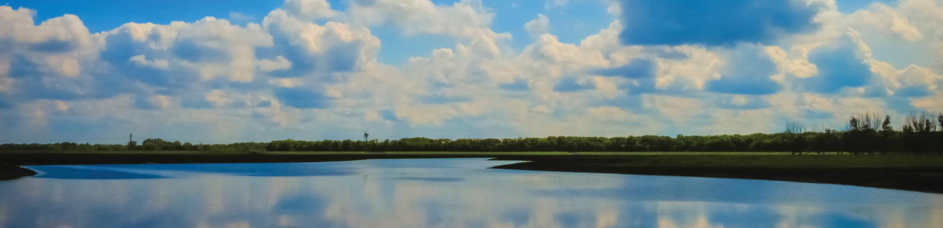
Minnesota Department of Agriculture
Susan Stokes | Assistant Commissioner

Slide 42
MDA - Mission
The MDA’s mission is to enhance Minnesotans' quality of life by ensuring the integrity of our food supply, the health of our environment, and the strength of our agricultural economy.

Slide 43

MDA Statutory Authority
Lead agency for pesticide and inorganic fertilizer regulation and management
Primary legislative authority:
  MN Pesticide Control Law (18B)
  MN Ground Water Protection Act (103H)
  Delegated lead state agency for enforcing FIFRA
  (Federal Insecticide, Fungicide, Rodenticide Act)
  MN Fertilizer, Soil Amendment & Plant
  Amendment Law (18C)
  MN Agricultural Chemical Response and
  Reimbursement Account (ACRRA - 18D)
  MN Environmental Response and
  Liability Act (MERLA – 115B)

Slide 44

Statutory Authority
Under the Groundwater Protection Act (103H), MDA is responsible for agricultural chemicals (pesticides and fertilizers)
MDA monitors groundwater if a contaminant is
commonly detected
Develops and promotes voluntary
Best Management Practices to prevent
or minimize contamination
Has rulemaking authority if BMPs have
proven ineffective

Slide 45




MDA Fertilizer Best Management Practices
MDA is lead agency for developing fertilizer BMPs. Formally adopted after a public review process.
Based on years of U of M research, provides regional guidance on the “4-Rs”: the right rate, timing; placement; and source.
MDA supports research and demonstration work on practices that reduce nitrate leaching to groundwater.
  These include vegetative cover, BMP demonstrations and edge-of-field monitoring of practices.
Notes:
Slide language is adequate but add the following comments:
Developed on a regional approach because of the vast differences in soils, rainfall, geology and cropping systems;
BMPs are formally adopted after a public review process;
In the past 7-8 years, much of the needed continuation research has been supported by farmers through either AFREC (your fertilizer tonnage fees at work) or via your commodity group check off funds;

Slide 46

Nitrogen Fertilizer Management Plan
It is the state’s blueprint for minimizing groundwater impacts from the use of nitrogen fertilizer
First NFMP published in 1990. Revised in 2015 after extensive stakeholder and public input.
Encourages and promotes science-based practices to reduce nitrate in groundwater while maintaining farm profitability
Targets areas vulnerable to groundwater contamination
Emphasis is placed on prevention
Notes:
This plan was developed with input from the ag community and is based on experience the MDA has had with farmers over the years.
Original plan was developed in 1990.

Slide 47

Current Conditions in Vulnerable Areas
Approximately 10.5% of 25,000+ private wells tested in vulnerable areas exceed the nitrate standard
In some townships 30 - 40% of the wells exceed the nitrate standard; recent data from SW MN is even higher
Approximately 30 Drinking Water Supply Management Areas have nitrate levels greater than 5.4 mg/L
Notes:
Message - we care about what people are drinking. Which is why we are sampling drinking water wells in TTP.
Last bullet - the wells will change. Working with the MDH to determine where these DWSMAs are.
For DWSMAs - won't use mixed water, it needs to be attributable to a single well.

Slide 48


Minnesota Agricultural Water Quality
Certification Program
MAWQCP is a voluntary program that offers producers:
- Recognition
- Financial/Technical assistance
- Regulatory certainty
- Branding/Marketing opportunity
- Check-up/Validation for growers
Whole-farm planning for water quality;
risk assessment of every parcel, every crop
Pairs producers with professionals to develop
site-specific solutions for risks to water quality

Slide 49




MAWQCP Status
Certification Status as of January 7, 2019:
692 certified farms
450,696 certified acres
1,331 new best management practices that have yielded:
  127 million pounds of soil saved per year
  50.2 million pounds sediment reduced per year
  20,525 pounds of phosphorus prevented from entering our waters per year
  49% estimated reduction in nitrogen loss

Slide 50






MAWQCP Partners
Agency Partners
Private Partners
Precedent setting partnership agreement
BWSR: Certification is ‘approved alternative practice’ for buffer law
PCA: MAWQCP key strategy Nutrient Reduction Strategy; Permits & review priority; EPA designated agency
DNR: DNR will pursue certification for all DNR-owned farmland
USDA-NRCS: technical & financial assistance
Ag Retailer & Consultant
12 packs of beer to certified farmers
Cedar River Watershed Partnership

Slide 51


MDA – Other Initiatives
Forever Green focuses on developing crops such as winter annual and perennial crops to ensure agricultural production to strengthen economies while protecting water and other natural resources. Funds pass through MDA to University of Minnesota.
Other Research and Demonstration Projects
  Nutrient management initiative – On-farm comparison trials of BMPs
  Rosholt Farm
  Clay County Drainage Project
  Root River Field to Stream
  Partnership

Slide 52

MDA – Incident Response Program
Emergency Response
Agricultural Chemical Voluntary Investigation
and Cleanup (AgVIC)
Comprehensive Facility
Investigations
State Superfund (MERLA)
Investigations
Former/Abandoned Sites
Project

Slide 53

Groundwater Protection Rule
MDA has proposed a Groundwater Protection Rule under the 1989 Groundwater Protection Act
  Two comment periods in 2017 and 2018. Nearly 4,000 written comments.
  24 public meetings attended by close to 2,000 people
  Revisions were made in response to farmers’ and others’ concerns
  Final approval by the Chief ALJ on 11.29.18
  Adoption of rule delayed until after
  2019 Legislative Session

Slide 54

Minnesota Department of Health
Tom Hogan | Environmental Health Division Director

Slide 55

MISSION
Protecting, maintaining, and improving the health of all Minnesotans
VISION
The MDH vision is for health equity in Minnesota, where all communities are thriving and all people have what they need to be healthy.
Notes:
Water is essential to thriving communities. In public health, we are constantly looking at the health of communities and what conditions are needed for healthy communities. At MDH we have responsibilities for drinking water, but we also work with communities on other aspects of water that affect people’s health;
Monitoring beaches for safe swimming,
preventing waterborne disease outbreaks from restaurants,
healthy teeth,
giving advice on avoiding contaminants in fish, and
maintaining an excellent laboratory and accrediting private labs across the state.

Slide 56


Safe drinking water for everyone, everywhere.
Notes:
Though we take safe drinking water for granted in Minnesota, it certainly is essential. Our vision is that everyone, everywhere in Minnesota has safe drinking water.

Slide 57

Why We Do It: Public Health In Action
Prevention
Health Equity
Support Economic Development
Notes:
Prevention:
disease from water-borne bacteria, viruses, or other harmful microorganisms
health effects from naturally occurring contaminants and industrial pollutants
dental cavities and fluorosis
Health equity for Minnesotans who:
drink from private wells
drink from smaller public water supplies with limited resources
have to pay to remove contaminants introduced by others
have a lead service line
eat contaminated fish
lack access to lakes, rivers for recreation
Support economic development:
Communities, schools, businesses, and farms rely on a consistent supply of safe water.

Slide 58

Minnesota’s Sources of Drinking Water
Minnesota has 7000 public water supplies.
1000 community systems
6000 non-community systems
Minnesota also has 480,000 private wells.
3 out of 4 Minnesotans get drinking water from groundwater.
41 communities drink from lakes and rivers.
PUBLIC WATER
80% (4 million)
PRIVATE WELLS
20% (1 million)
GROUNDWATER
75%
SURFACE WATER
25%
Notes:
Public = served to the public, not publicly owned
Community = where people live and likely drink the most water, most highly regulated
Non-community = where people work and play, people get less water from these places
Reminder: the numbers in the image represent # of people or percentage of people, but most of the numbers in text refer to number of systems and/or communities.

Slide 59

MDH Authorities
Minnesota Well Code, 1972
Well location
Well construction
Federal Safe Drinking Water Act, 1974
Source water protection
Treatment and distribution
Groundwater Protection Act, 1989
Develop and adopt health-protective guidance
Notes:
Our primary authorities provide us with 3 public health tools to protect drinking water from source to tap. There are other general authorities as well.
Well Code – where and how you construct a well to prevent contamination of the drinking water
SDWA- federal legislation for which MDH has “Primacy.” Includes regular testing for > 100 contaminants, treatment rules, lead and copper requirements, and provides a basic level of protection.
GWPA – directs us to develop strictly human health-based guidance that denotes when GW as a source of potential source of drinking water is “degraded.”

Slide 60

Healthy Water, Healthy People
Protect sources of drinking water
Test and inspect public water systems; enforce standards
Regulate well location and construction
Train water operators and well contractors
Educate private well users
Certify water-testing laboratories
Assess health risks of contaminants with new concerns
Track and prevent waterborne disease outbreaks
Notes:
We ensure safe and sufficient drinking water through a series of strategic safeguards, from source water to the taps in people’s home. Some activities include: see the slide.

Slide 61
Partners in Public Health Protection
City utilities
Nursing homes, prisons, and dorms with their own water supply
Faith communities, daycares, schools, camps, parks, small businesses, and industries
Well contractors
Homeowners
Cities, counties, soil and water conservation districts, and farmers
Commercial laboratories
Special events: Minnesota State Fair, WEFest, Renaissance Festival, county fairs, and wedding centers
Notes:
We rely on partners from every level of government, all sectors, non-profits, and citizens to help us meet our mission. Everyone has a role to play, especially with more recent, emerging threats that come from the products we use every day or the ways we use our land.

Slide 62
Resources
Funding Sources
Expertise at MDH
General Fund
Safe Drinking Water Fee
Clean Water Fund
Legislative-Citizen Commission on Minnesota Resources (LCCMR)
US Environmental Protection Agency (EPA)
Agency for Toxic Substances and Disease Registry (ATSDR)
Public health sanitarians
Planners
Hydrologists
Toxicologists
Communicators
Lab technicians
Engineers
Notes:
Funds to support our public health actions come from a variety of sources. (mention the fee here?)
As important as the dollars are the considerable expertise of MDH staff. Nationally we are recognized for our cutting edge work on many drinking water issues:
Recent paper on how to develop a safe number for consuming PFAS over a lifetime that takes into consideration multiple generations; mom and babies.
Piloting electronic communication of water quality reports from utilities to their customers

Slide 63

Clean Water Fund at MDH
Gather and share information about groundwater resources and drinking water wells
Learn more about the health risks from chemicals, pathogens, and naturally occurring elements
Help communities protect their drinking water for current residents and future generations
Notes:
Clean Water Funds help us to go above and beyond our traditional activities to take steps to protect drinking water into the future for generations to come.
Clean Water Funds have helped MDH:
gather and share important information about groundwater resources and drinking water wells (arsenic study in private wells, private well education, reducing waterborne illness from pathogens [virus study], enhancements to the Minnesota Well Index)
learn more about the health risk from chemicals, pathogens, and naturally occurring elements (developing health-based guidance to protect Minnesota’s most vulnerable populations, safe and sustainable water reuse, Lake Superior beach monitoring)
help communities protect their drinking water for current residents and future generations (source water protection grants, groundwater restoration and protection strategies (GRAPS), sealing unused wells)
MDH has received 37 million dollars to enhance drinking water protection efforts through the Clean Water Fund.

Slide 64

Creating the conditions for healthy communities.
Notes:
Thank you for listening. We’d be glad to answer questions or come back and present on a topic in greater detail.

Slide 65
Water Resource Management – A statewide effort
Water is central to the core mission of many state agencies.
Minnesota Water Management Framework ensures work is coordinated across agencies and with local water management.
Goals: Clean and sustainable water
Notes:
PAIR WITH HANDOUT OF WATER MANAGEMENT FRAMEWORK
Water is central to the core of the mission of many state agencies therefore there are water programs in many agencies. These agencies work together to ensure the state has a comprehensive approach to water issues to ensure
Department of Agriculture
Metropolitan Council
Minnesota Board of Water and Soil Resources
Minnesota Department of Health
Minnesota Pollution Control Agency
Public Facilities Authority
Each agency
DNR – conserving natural resources, providing outdoor recreation and providing commercial use of natural resources in ways to sustain quality of life

Slide 66

Thank You!

