Slide 1
Current and Emerging Water Issues
William Arnold
Civil, Environmental, and Geo- Engineering
University of Minnesota
Notes:
Legislative Water Commission on point on a lot of issues

Slide 2
Acknowledgments/Crowd Sourcing
UMN, CEGE
John Gulliver
Paige Novak
Tim LaPara
Ray Hozalski
Paul Capel
UMN, SWAC
Brandy Toner
UMN, IonE
Kate Brauman
UMN, HHH
Bonnie Keeler

Slide 3
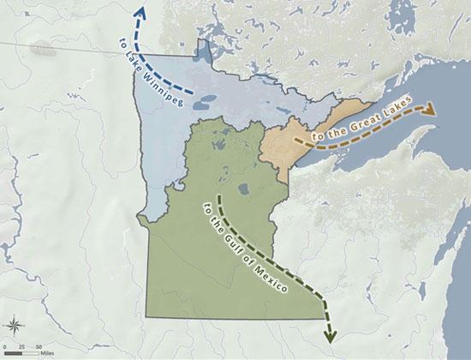
Population Growth & Land Use
Climate Change
Water Quantity
Water quality
Infrastructure, Treatment Needs, Environmental Health
Public Trust

Slide 4
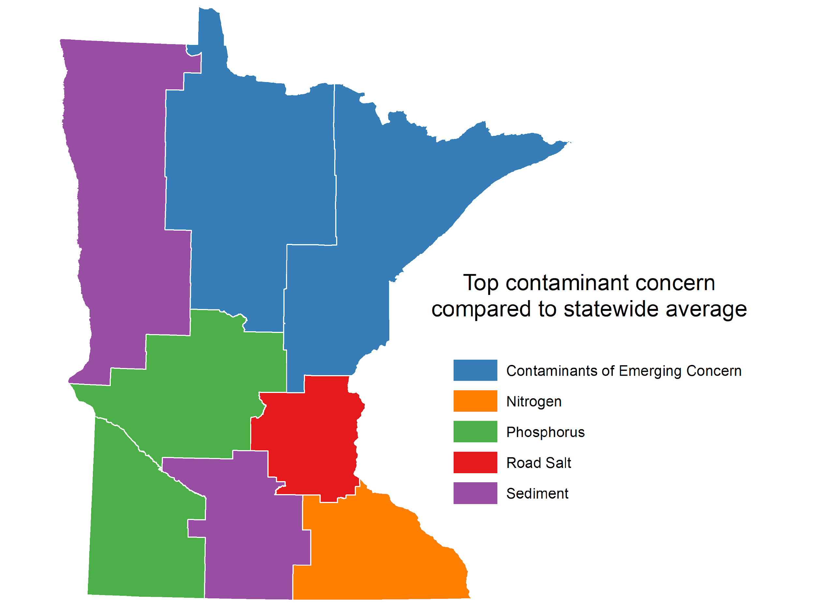
Chemicals and Microbes
What’s in the water?
Pharmaceuticals, estrogens, pesticides (CECs)
Nutrients
Chloride
Viruses
Bacteria
Courtesy of Bonnie Keeler
Notes:
25 by 25 town halls
MN people know about chemical pollutants
Microbiological also important

Slide 5
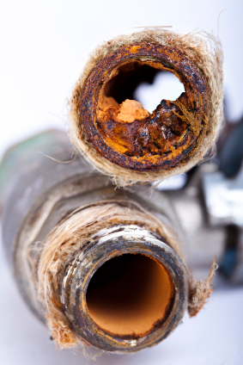
Drinking Water
Nitrosamines
Contaminants of Emerging Concern
PFAS
Pharmaceuticals
neonicotinoids
Opportunistic pathogens
Release of monomers, curing agents
Upgrade treatment?
Infrastructure replacement?
Notes:
Nitrosamines are carcinogens formed during specific disinfection conditions if precursors present (wastewater often a source of precursors, so water
Talk more about PFAS later
Recent work from Iowa suggests neonics in drinking water

Slide 6
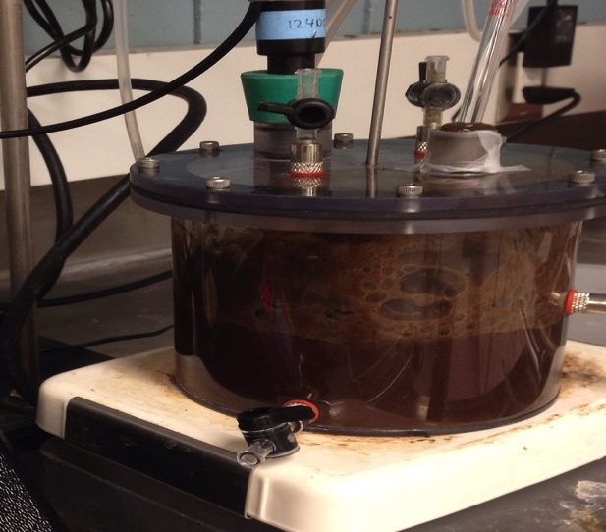
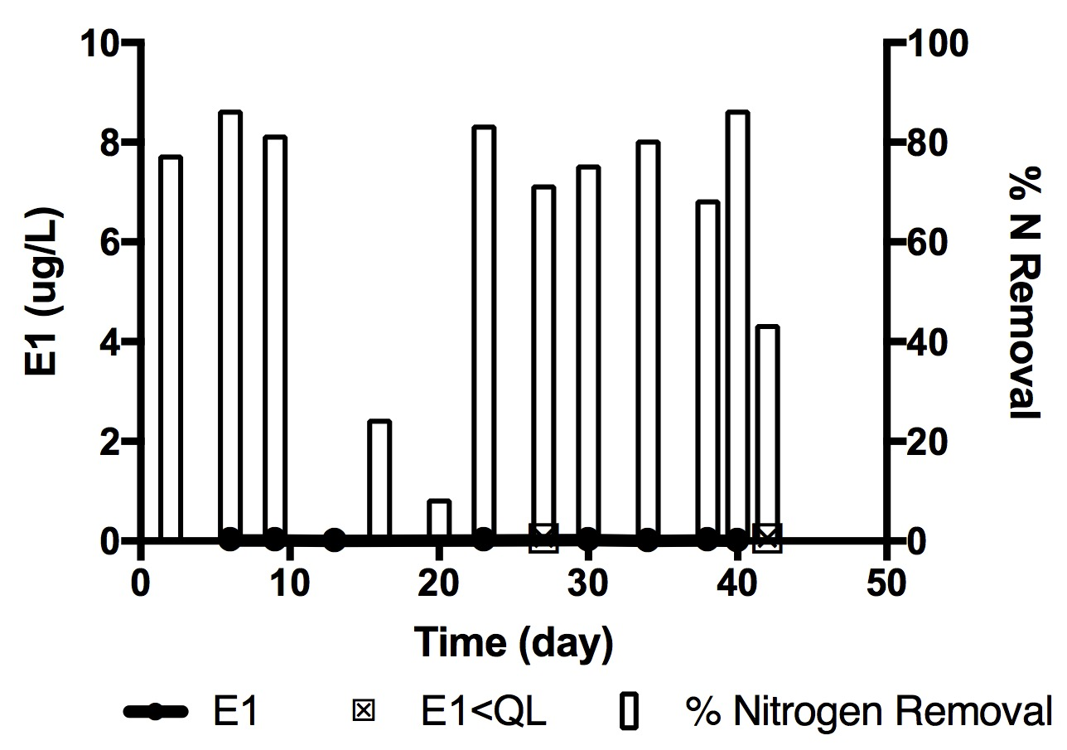
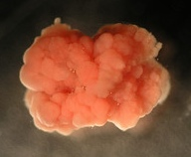
Wastewater
Low energy/energy positive treatment
How do we recover resources better?
Protect ecosystems from Contaminants of Emerging Concern
Upgrade treatment?
Sewer detectives? (opioids?)
Infrastructure replacement?
Encourage innovation
Peterson, K. N., et al.. 2017Environmental Science: Water Research & Technology, 3:1051-1060.
Notes:
Innovation needed in this sector – lots of value in what we currently spent a lot of money and energy to treat.

Slide 7
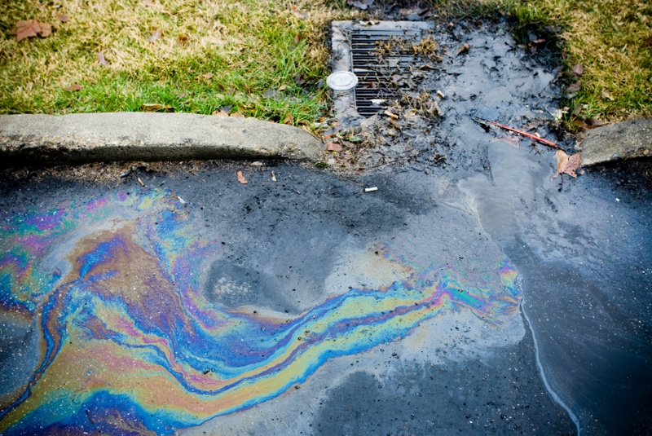
Stormwater
Collection and Reuse
Wide variety of chemicals
Microbial risks (aerosols)
Tire wear particles/chemicals
Chloride
Risks may outweigh benefits of deicing
Water softeners
Effective use, alternatives
Removal?
Notes:
Regulations on re-use may need to be looked at.
Where do we use salt? Perhaps sand is good enough in parking lots….
No easy/cheap way to remove chloride

Slide 8
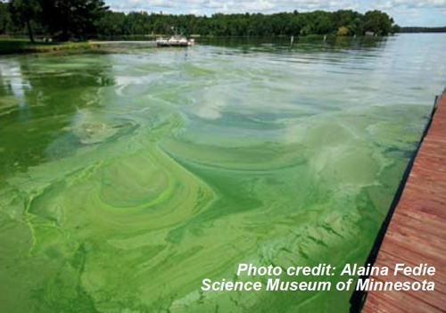
Old Pollutants, New problems
Nitrate
Phosphorus
External
Internal
Sediments
Nutrients + Climate (+ pesticides?) = Harmful Algal Blooms (HABs) = aesthetic and toxin issues

Slide 9
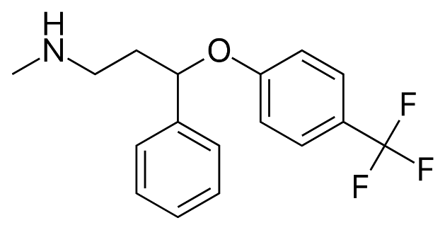
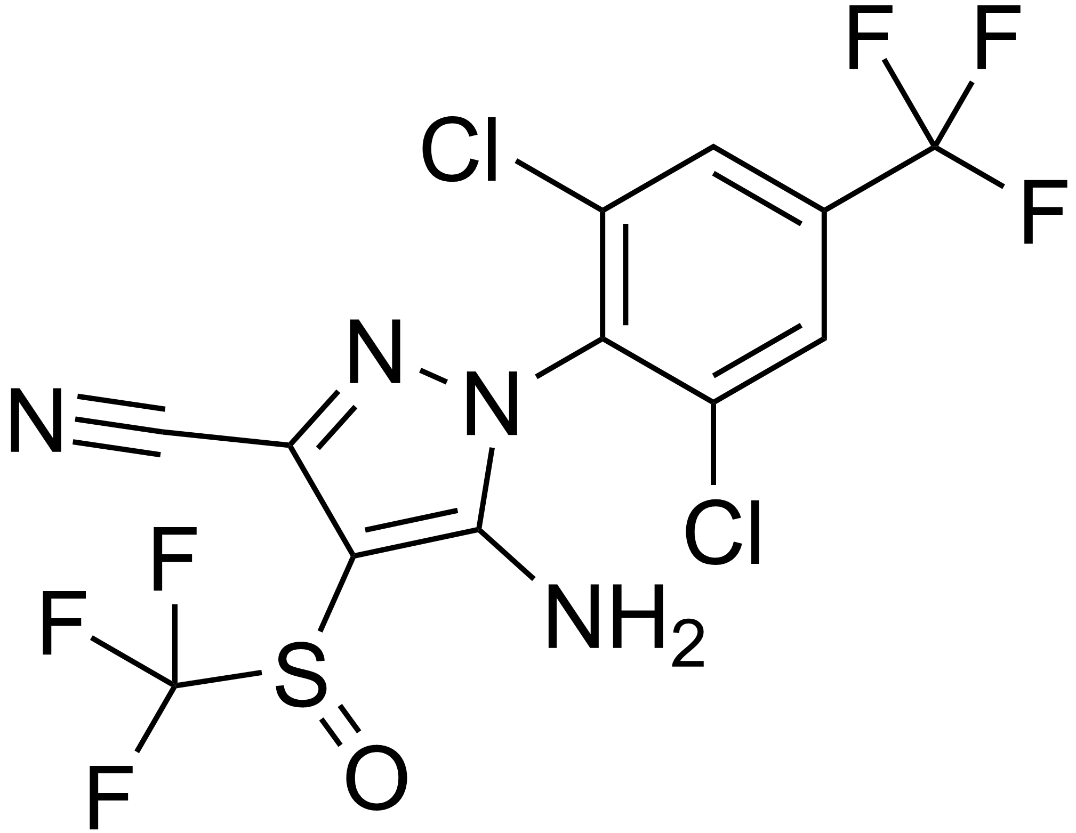
Fluorinated Chemicals
Per- vs. Poly- vs. pharms/pesticides
Manufacture
Use
Fire training activities
Groundwater, surface water, drinking water, wastewater, and storm water issue

Slide 10
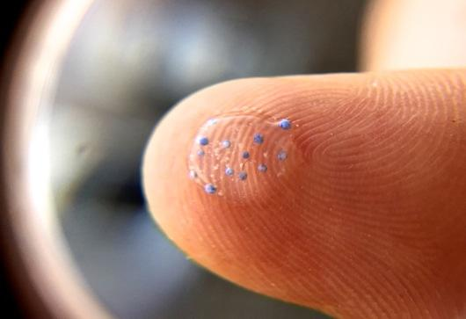
New Pollutants
New products introduced to market
Pesticides
Pharms
Consumer products
Nanomaterials/metals impregnated in clothing
Plastics
Wear particles
Purposeful introduction
Monomer, polymers, particles
Image credit: MPCA
Nanomaterials may also be solutions to pollution problems!!!
Notes:
Complete environmental assessment of new products expensive/time consuming.
Need a better way

Slide 11
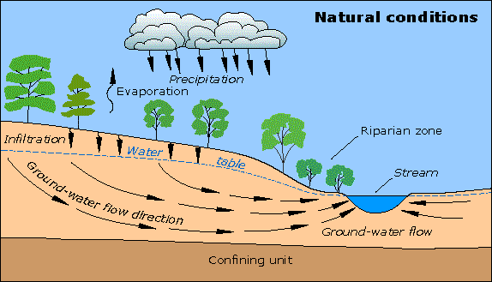
Groundwater
Source/well head protection
Nitrate
Viruses
Declining levels (overuse, climate, lack of recharge)
Notes:
We take groundwater, drink it/flush toilets with it, the send it to WWTP and the river == not sustainable.

Slide 12
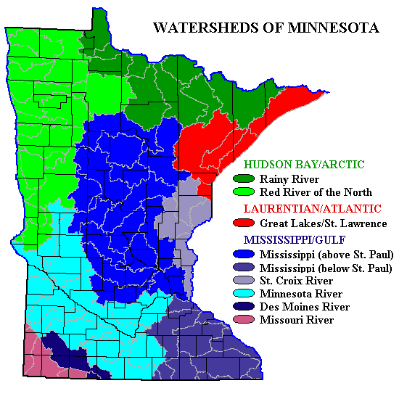
Watershed/Surface Waters
Manure management
Bacteria
CECs
Erosion
Land use, climate
Mining
Metals, sulfide
Effects of urbanization
Stormwater control
Climate change

Slide 13
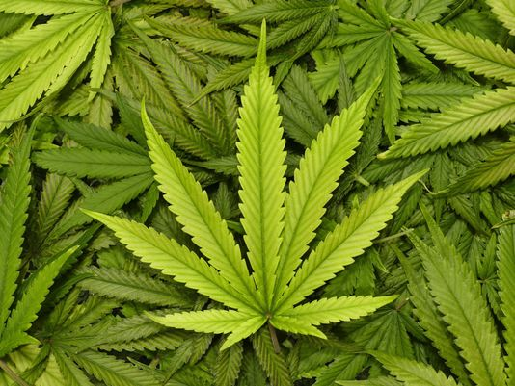
Other decisions may affect water….
How much water is needed?
What chemicals/nutrients are applied?
Do bioactive compounds leach from live plants?
Notes:
New policies, products, regulations (or removing regulations) may have unanticipated water impacts.

Slide 14
Change is coming Innovation is needed
Business as usual will stress
Sustainable water quantity
Sustainable water quality
Human well being
Environmental welfare
Agriculture
Industrial productivity/profits
Impacts of climate change
Virus/bacterial monitoring & treatment
Chemical design, marketing, regulation
Treatment technologies
Water management (and treatment) strategies
Recharge groundwater?
reuse
Infrastructure rehabilitation and upgrades
Notes:
Management and reuse can lead to other issues
-NDMA, contamination of groundwater with CECs, aerosolization of microbes if storm/wastewater used for irrigation

