Slide 1
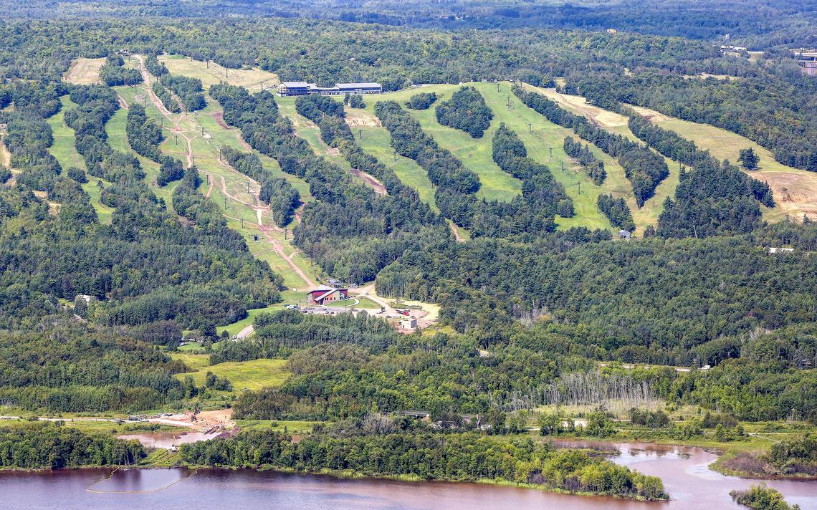


Duluth Spirit Mountain Tourism Industry Infrastructure
Credit: Duluth News Tribune

Slide 2


The Legislature Established Spirit Mountain in 1973 to:
Provide year-round outdoor recreation opportunities for all Minnesotans
Bolster the economy of northeastern Minnesota
Preserve a spectacular natural resource
Notes:
The Legislature established the Spirit Mountain Recreation Area in 1973 to:
Provide year-round outdoor recreation opportunities for all Minnesotans
Bolster the economy of northeastern Minnesota, and
Preserve a spectacular natural resource

Slide 3
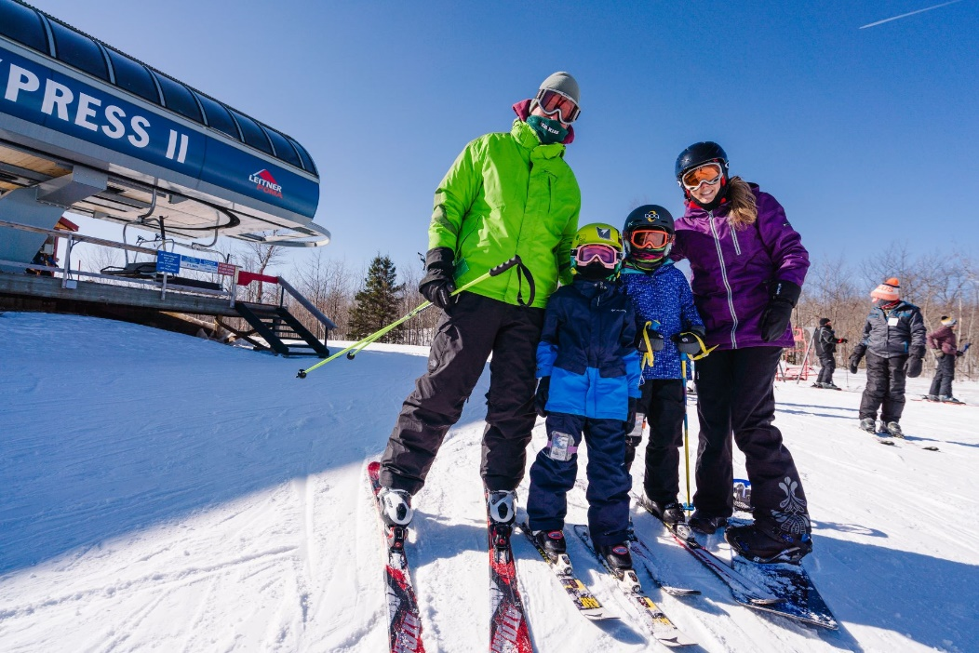
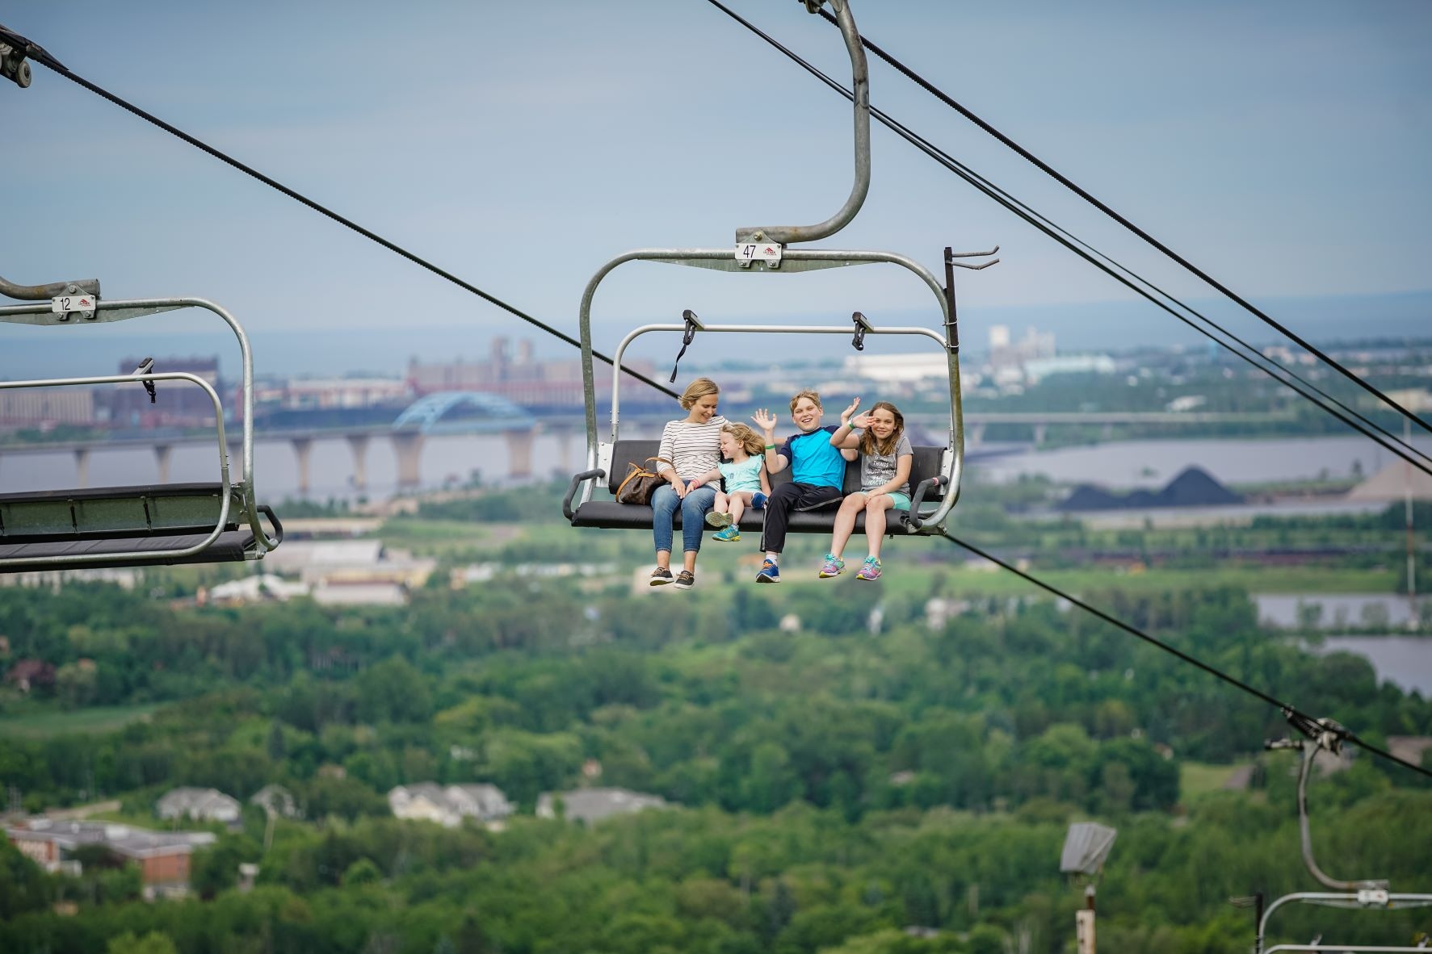
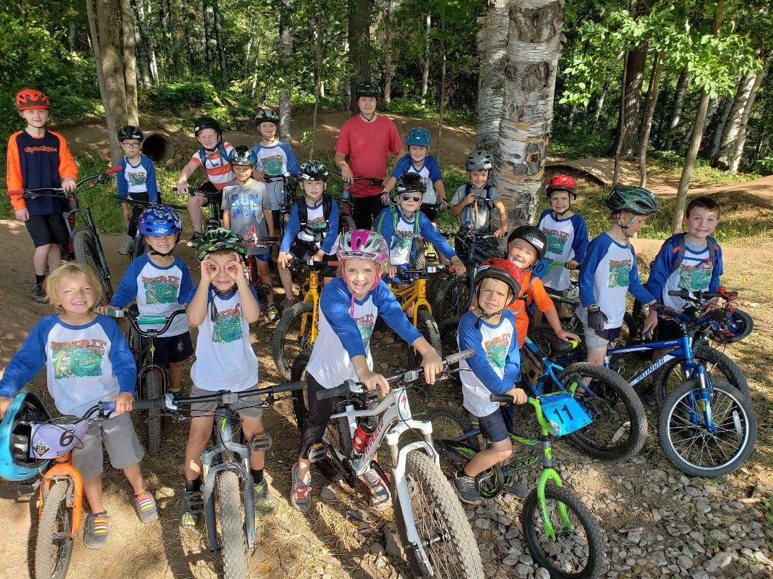
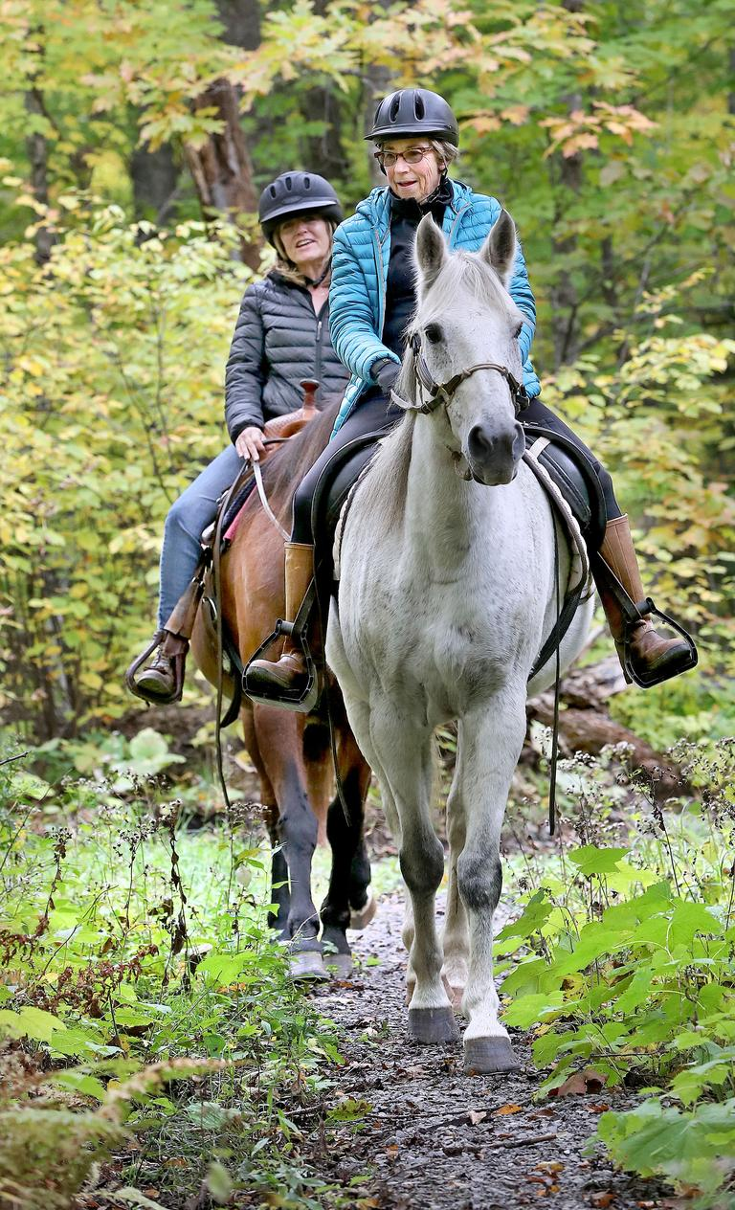
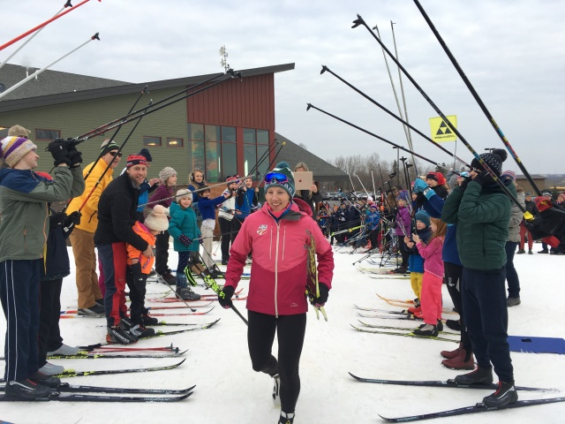
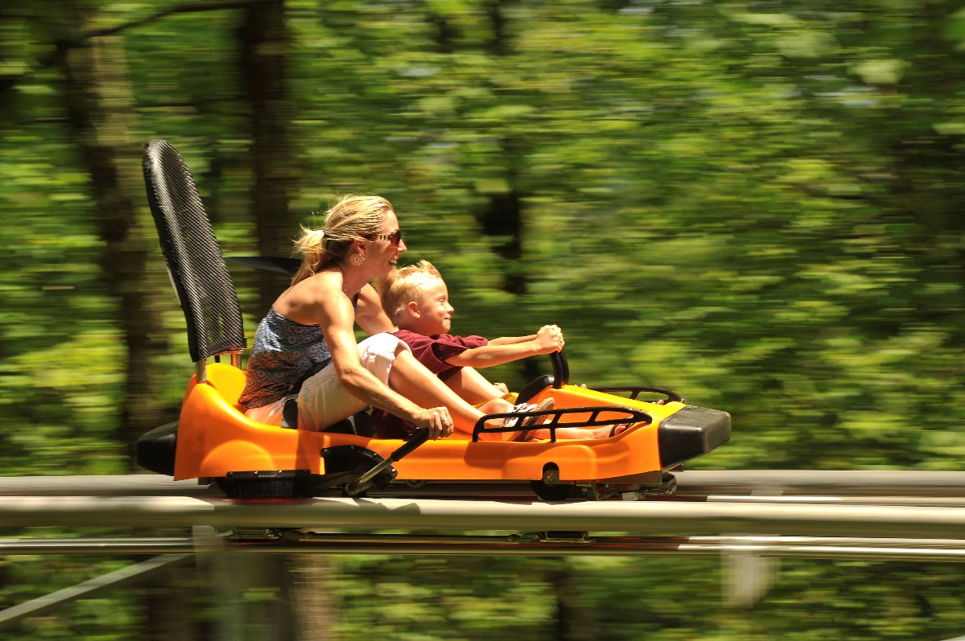
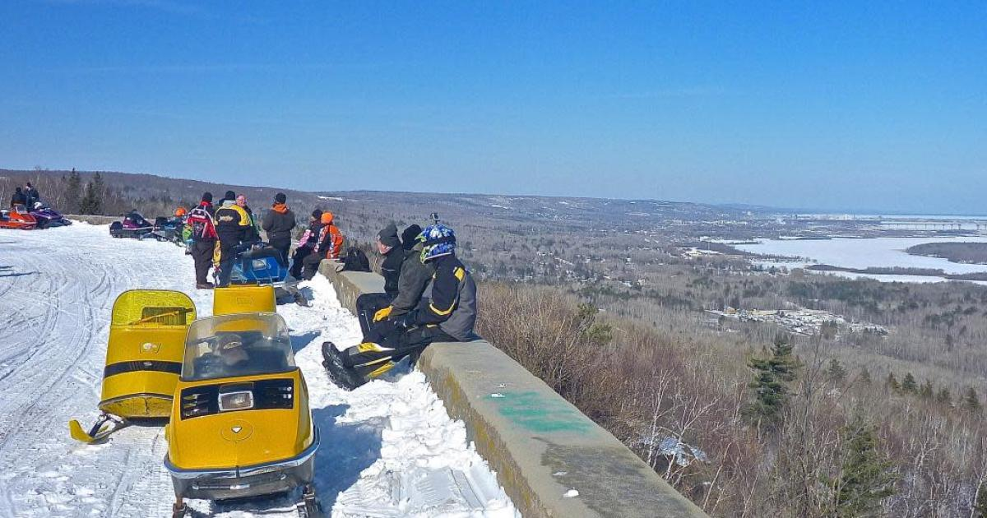
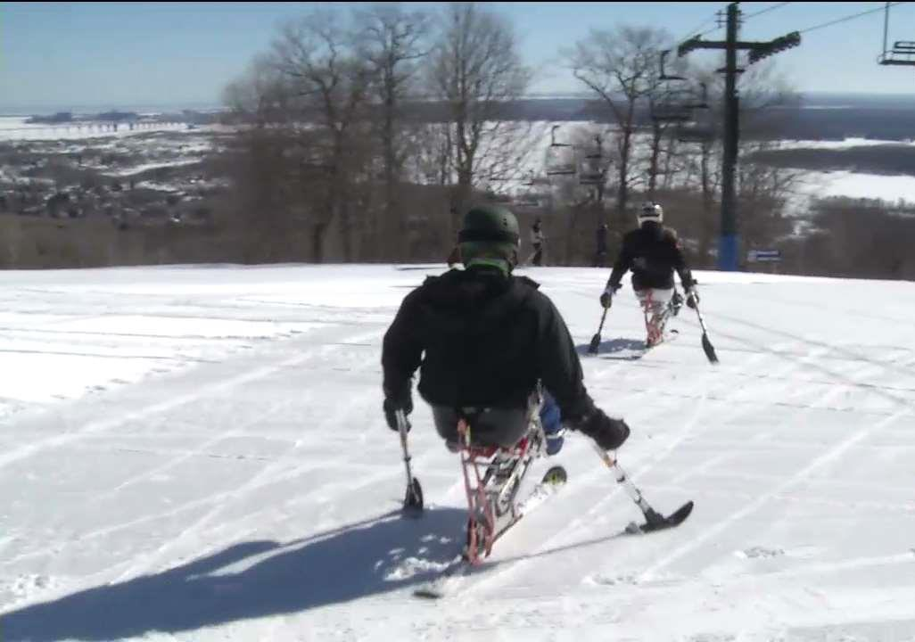
Year-Round Outdoor Recreation for ALL
Notes:
Spirit Mountain has abundantly realized the legislature’s vision of a year-round recreation destination.
There is something for everyone – camping, skiing, dining, snowmobiling, mountain biking, hiking, scenic chairlift rides, weddings and events, youth camps, adaptive recreation programs, an adventure park, etc.
The quality of the facilities is as impressive as their breadth, from a cross-country skiing center that will host US Olympic team qualifying later this year to a mountain biking trail system that the International Mountain Biking Association year after year names among the six best on the planet.

Slide 4
Regionally Significant Economic Impact
2019
Total Economic Impact | $22 Million
Jobs Created | 301 Full-Time-Equivalents
Annual Visitors | ~250,000 Visitors
Notes:
Outdoor recreation facilities of this caliber are just the powerful driver of economic activity that the 1973 Legislature envisioned.
An independent economic impact analysis showed that, in 2019, Spirit Mountain:
Generated more than $22 million in sales activity
Directly and indirectly supported 301 full-time-equivalent jobs
Drew more than 250,000 visitors, many of them in winter.

Slide 5
A Destination for All of Minnesota and the Midwest
*Visitor Origin | % of Spirit Visitors (Approx)
Duluth | 20%
Other Minnesota | 65%
Other States | 15%
*For the period Fall 2020 to Fall 2021
Top 50 residences of 21 Spirit visitors
Notes:
Spirit Mountain visitors come from all over Minnesota and the Midwest.
In the last year, approximately 20% of paid Spirit visitors were from Duluth, 65% were from other places in Minnesota, and 15% were from out-of-state.
The graphic on the right shows the top 50 places of residence of Spirit visitors in this period.
Much as the 1973 legislature must have hoped, Spirit is, at once, a destination for Chicago and the Iron Range, for Fargo and Brainerd, for Madison and Rochester, for the people of Duluth and those throughout the Upper Midwest.

Slide 6
A Destination at Risk
Spirit Infrastructure | Year Constructed/Age
Summit Chairlift | 1974/ 47 Years
Double Jaw Chairlift | 1974/ 47 Years
Gandy Chairlift | 1976/ 45 Years
Main Lodge | 1974/ 47 Years
Campground | 1974/ 47 Years
Notes:
Unfortunately, Spirit Mountain is at increasing risk due to aging infrastructure. Critical infrastructure including three chairlifts, the main lodge, and the campground all date from the first two years of Spirit Mountain’s existence, nearly half a century ago. While these assets have been responsibly maintained, they have reached an age where only replacement or comprehensive renovation will suffice.

Slide 7
The Spirit Mountain Task Force
16-person Mayoral task force
Supported by ski industry consultant
20 meetings over nearly a year
Comprehensive report and recommendations including major capital reinvestment
Notes:
Recognizing the approaching crossroads, Mayor Larson in 2020 appointed a 16-person task force, supported by ski industry consultants, to thoroughly study Spirit Mountain and advise the City on how best to steer Spirit into its next 50 years of service.
The task force met 20 times over nearly a year and, in early 2021, issued comprehensive recommendations covering everything from governance and marketing to equity and inclusion.
One of the task force’s strongest recommendations was the time-sensitive imperative to address deteriorating infrastructure with a $24 million comprehensive capital reinvestment plan.

Slide 8
$24 Million Spirit Mountain Capital Investment Plan
Main Lodge Renovation | $11.8m
Lift Replacement and Renewal | $3.6m
Adventure Park Renewal and Expansion | $1.9m
Snowmaking System Renewal and Expansion | $1.2m
LED Lighting Conversion | $1.0m
Campground Renewal | $.6m
General Maintenance | $.9m
Design and Contingency | $3.0m
Total | $24 Million
Notes:
The Task Force recommendations served as the basis for this capital investment plan which Spirit Mountain and the City of Duluth have refined on the basis of further analysis and design.
$11.8 million to renovate the main lodge and event center that is home base for all Spirit activities
$3.6 million for lift replacement and renewal
$1.9 million for renewal and improvement of the Adventure Park which provides a great outdoor experience unto itself and produces profits that help keep other Spirit activities affordable.
$1.2 million for snowmaking system renewal and expansion
$1.0 million to light the entire hill with energy efficient LED technology
$.6 million for campground renewal

Slide 9
Proposed Capital Investment Financing
State Bonding
$12 Million
Local Government
$12 Million
Total Investment
$24 Million
+
=
Notes:
To pay for this investment, the City of Duluth respectfully asks the Legislature to consider $12 million in bonding support for the project and commits to match that investment dollar for dollar.

Slide 10
Capital Investment will Boost Economic Impact
 | Pre-Investment | After Capital Investment
Total Economic Impact | $22 Million | $40 million
Jobs Created | 301 Full-Time-Equivalents | 506 Full-Time Equivalents
Notes:
The anticipated return on the state’s investment would be significant. Economists from the SE Group estimate that the capital improvements would increase the economic impact of Spirit Mountain, from an already impressive $22 million per year and 301 full-time jobs to a far greater $40 million per year and 506 full-time jobs.
Add the intrinsic benefits of another 50 years of healthy outdoor recreation at Spirit Mountain and we hope that you will agree that Spirit Mountain is worthy of state investment.

Slide 11
Thank you!
Questions?

