Slide 1
VINE Faith in Action promotes quality of life and a culture of caring, sustained by volunteerism, community engagement and support for neighbors in need.

Slide 2
About VINE
Established in 1995
Largest of the nation’s 450+ Faith in Action programs
Primary service area is Blue Earth and Nicollet Counties
Coordinates volunteers and services to assist people with long-term health needs or difficult life situations.
Work in partnership with AAAs, Department of Human Services, MNDOT, hospitals, health care organizations, congregations
Funding from a variety of sources: cost sharing (sliding fee scale),contributions, thrift store and other earned income, fundraising events, United Way, public and private grants
Learn more at vinevolunteers.com

Slide 3

VINE’s services are designed to help aging adults remain living in their own homes
State average cost for 1 year in nursing home (semi-private room): $81,395
State average cost for 1 year in Assisted Living Facility: $35,436
Remaining at home is cost effective:
VINE’s yearly cost for helping an older adult is $496
There is a wide-array of home care services available for purchase at a fraction of the cost of a move from home to customized living.

Slide 4
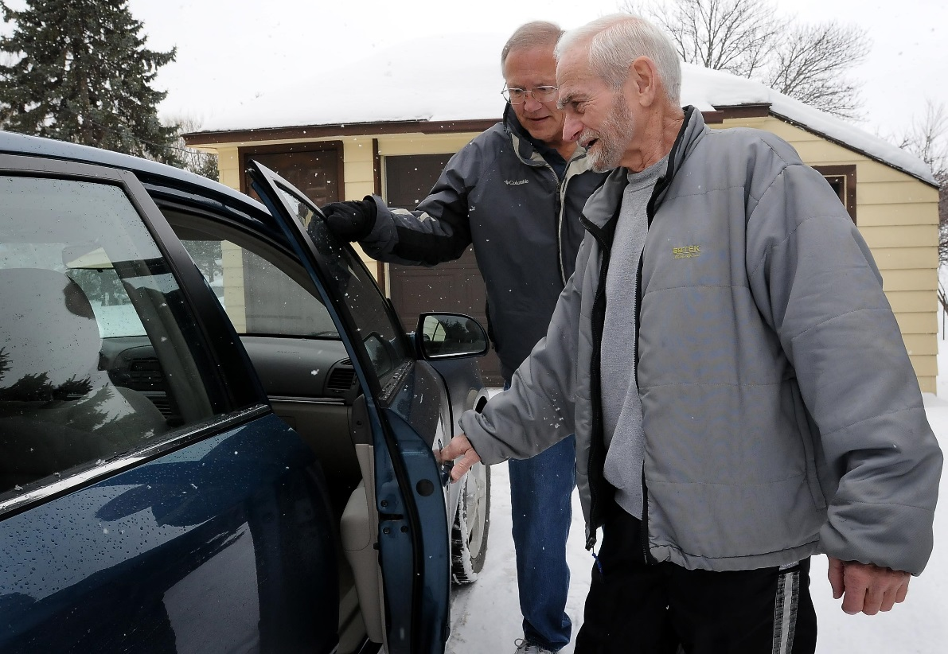
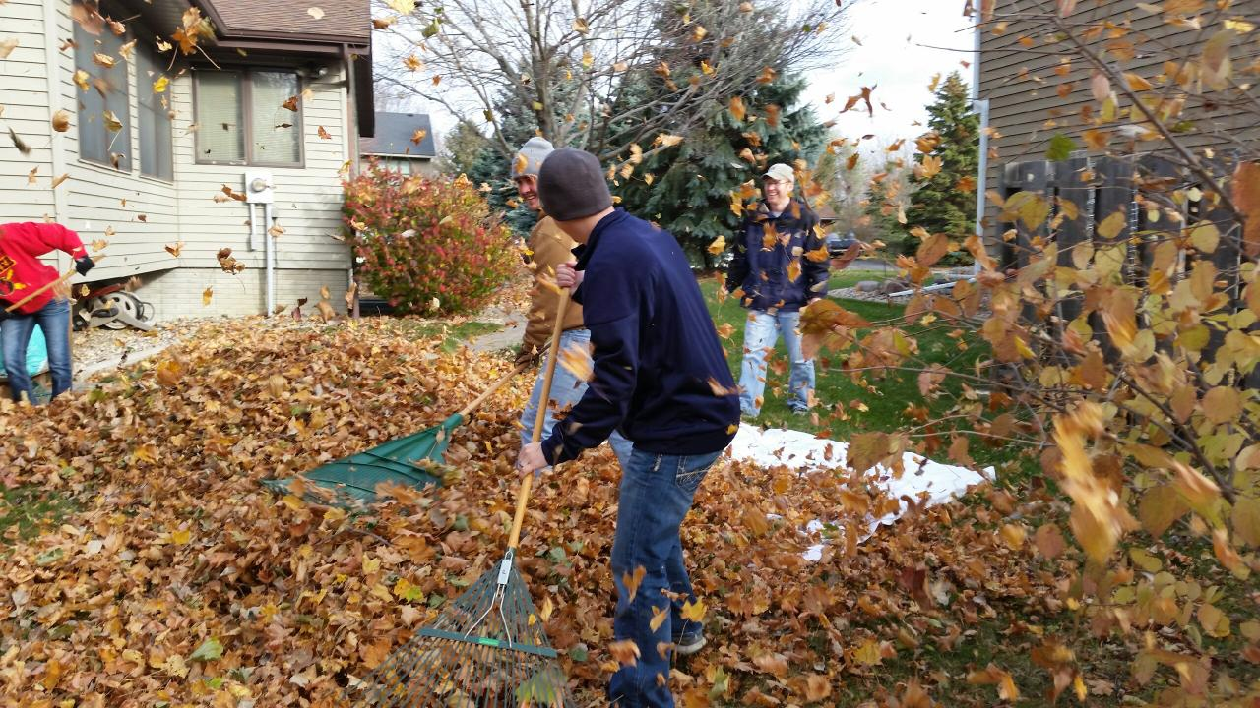
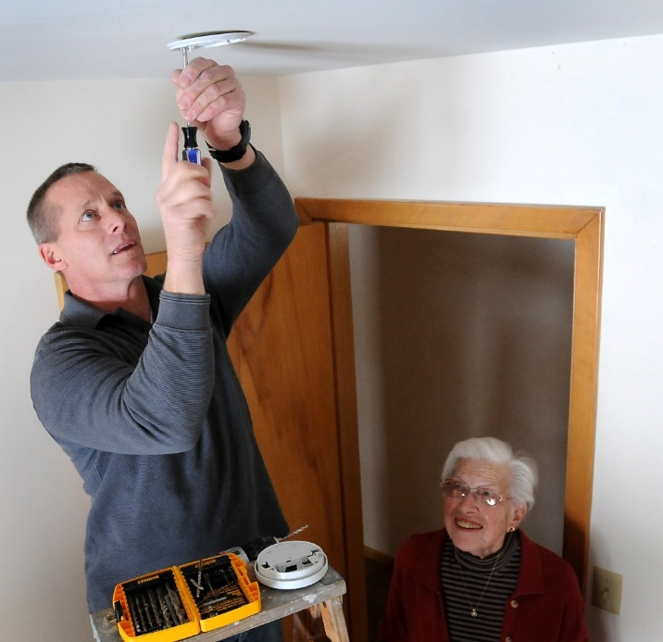
Transportation
People Assisted: 878
Chores
People Assisted: 634

Slide 5
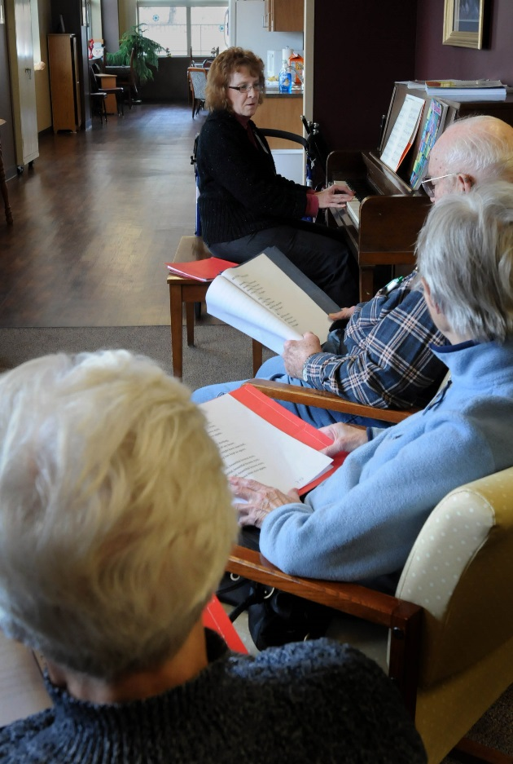
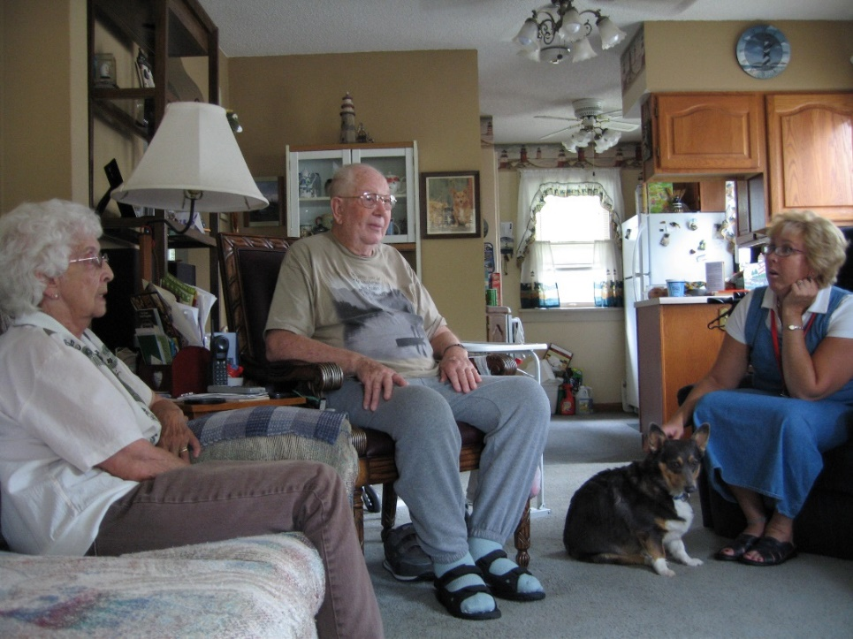
Support for Family Caregivers
People Assisted: 950
Adult Respite Center
Nursing Home and Hospital Transition Services
Durable Medical Equipment Loan Program
Support Groups
Coaching
Family Meeting Facilitation

Slide 6
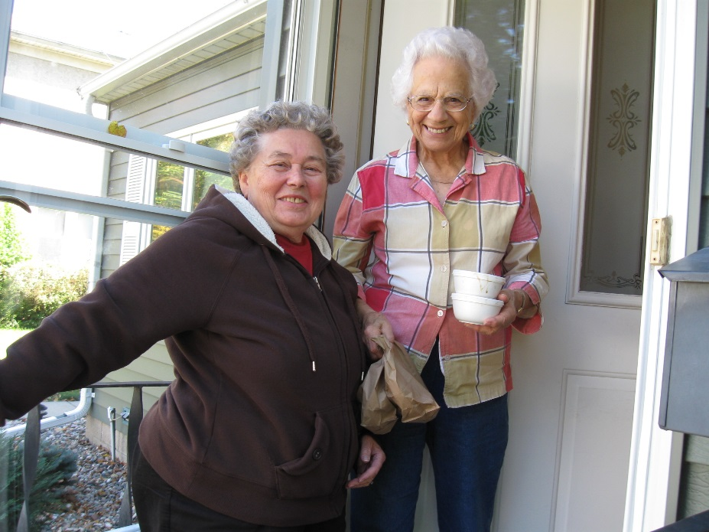

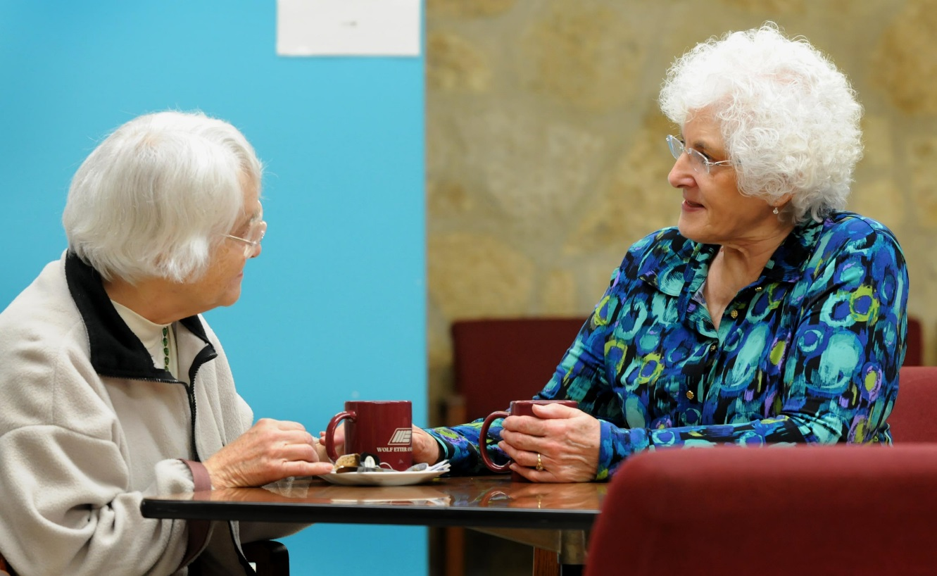
Hot Meals on Wheels
People Assisted: 113
Caring Connection Peer Mentor Program
People Assisted: 44

Slide 7
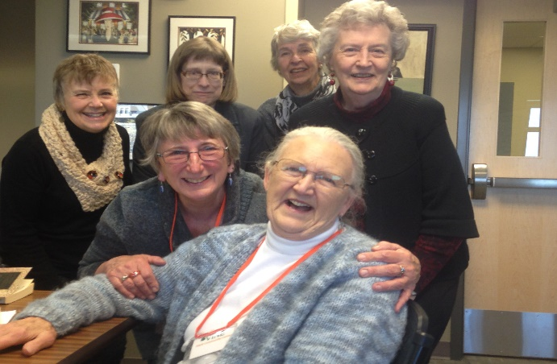
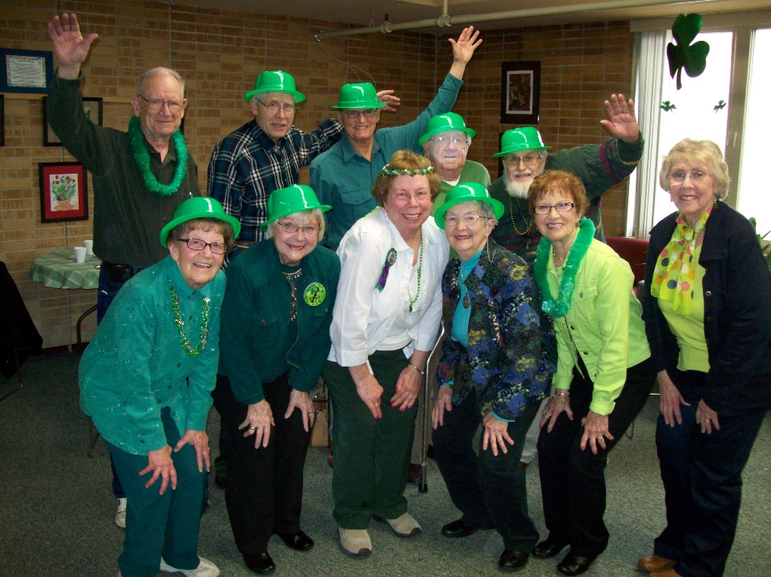
Successful aging involves much more than having clean windows or a ride to the doctor
Aging is not a disease; it is a unique season of life when people can:
redefine work and retirement,
focus on maintaining their health and personal independence, and
devote skill and energy to helping make life less difficult for others.

Slide 8
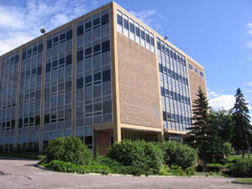
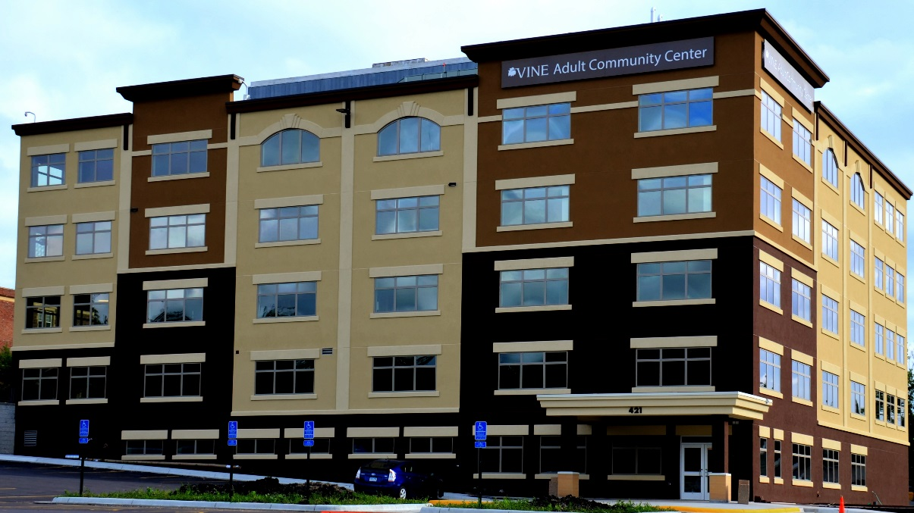
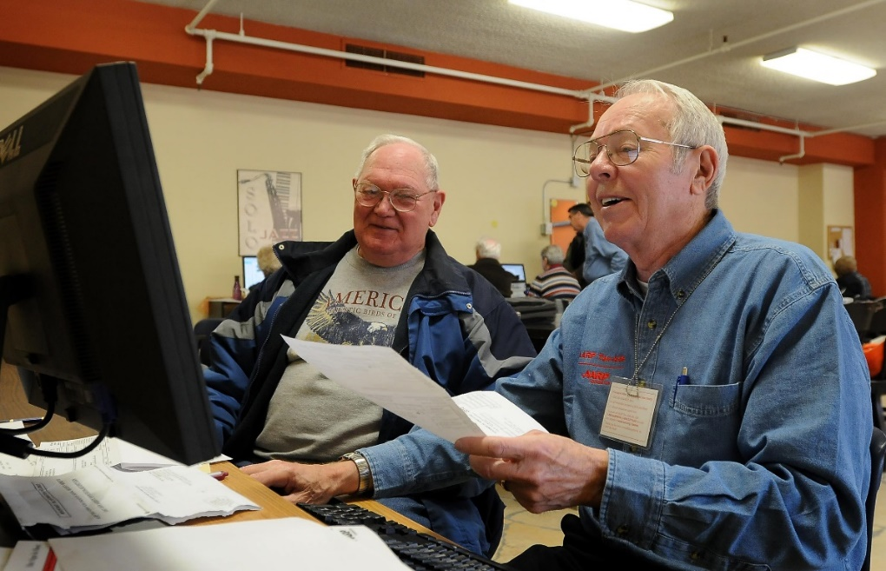
VINE Adult Community Center
A place where adults “in mid-life and beyond” can maintain their health, volunteer to help others, and enjoy life-long learning and positive aging.

Slide 9
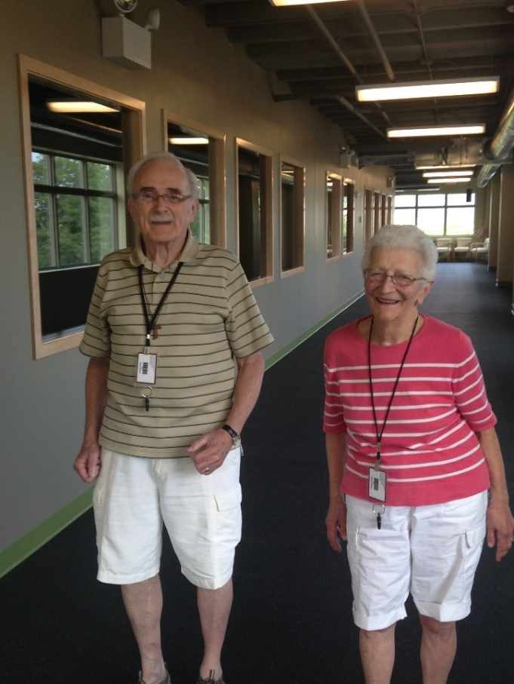
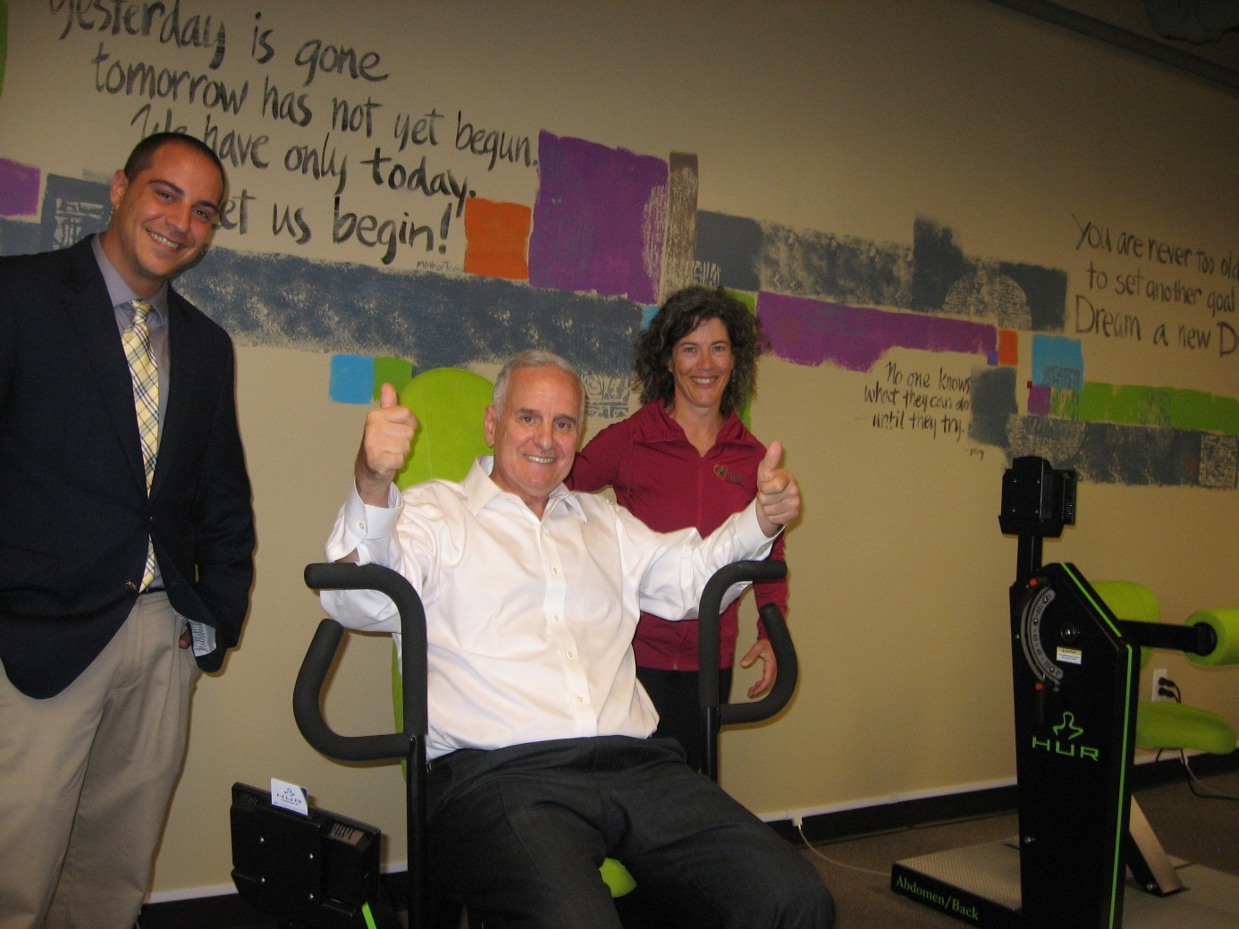
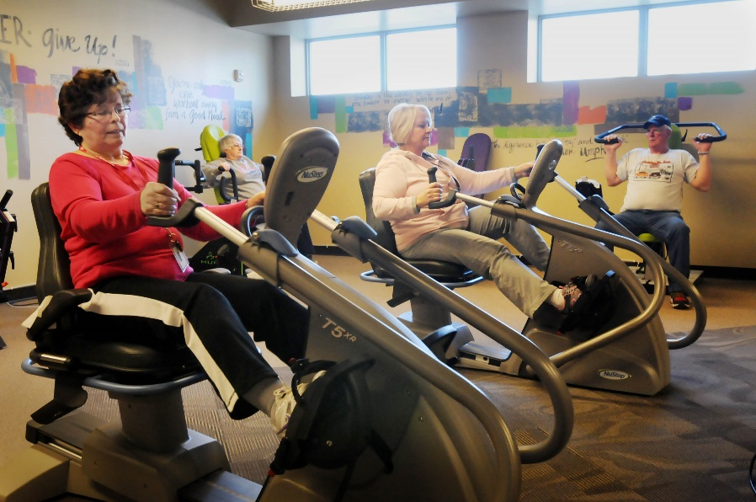
Fitness – HUR Machines & Track

Slide 10


VINE Enjoys a Long Term Partnership with the MN Department of Human Services
Competitive grant’s available to improve the community’s capacity to develop, strengthen, integrate, and maintain home and community-based services for individuals age 65 and over, at-risk of a permanent move from their home to a facility and/or spending down into Medical Assistance.
Dollar for Dollar Local Match Required
Live Well at Home Grants
www.mn.gov/dhs/live-well

