Slide 1

Governor’s FY2020-21 Budget Presentation
March 21, 2019
Commissioner Margaret Anderson Kelliher

Slide 2
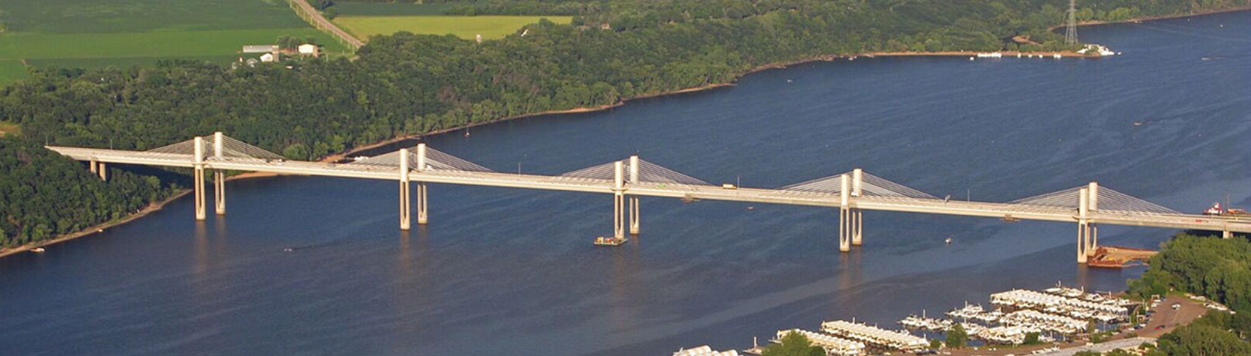
Comprehensive and Dependable Transportation Plan

Slide 3
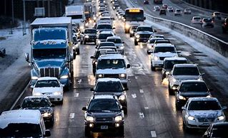
Growing Needs
Nearly 1 million new Minnesotans by 2050
Projected growth in vehicle miles traveled to increase 21.3% by 2040
Freight truck traffic to increase 40% by 2040
Connected, automated and electric vehicles
Significant funding gap

Slide 4

Funding Shortfalls
More than 50% of Minnesota state roadways and 40% of state bridges are 50 years old or older
Increasing deterioration of pavement and bridges
Little expansion to address population and economic growth
Reduction in high priority services delivered
    Snow and ice
    Repair potholes
    Bridge inspection and maintenance

Slide 5
The Funding Gap
The existing system needs additional resources to maintain and modernize our roads and bridges
Funding gap is largely the result of:
  Aging infrastructure
  Increased costs for construction & maintenance
  Population and freight shipments increasing
  Stable/flat federal funding
$18 billion
  projected between funding needs and estimated revenues for roads and bridges over the next 20 years
  ($6 billion in the next 10 years)

Slide 6
Investment in Transportation
Sustainable and constitutionally dedicated funding (Article 14, Minnesota Constitution)
Commitment to a long term investment plan for roads and bridges
Maintain/repair state bridges, modernize and improve safety, repair potholes, and address ongoing snow and ice issues
Return $452 million in statutorily dedicated General Fund revenues in FY20-21
Pay debt on $2 billion in trunk highway bonds

Slide 7
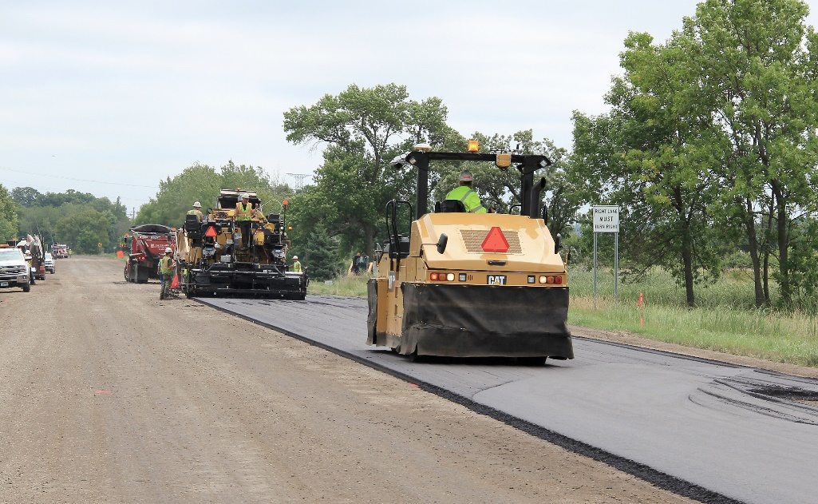
Community Prosperity
Repair and replace aging infrastructure
  1,800 miles of roadway
  Repair or replace 300 bridges on state highways
Modern materials and designs will provide longer and more useful lives
More efficient and reliable transportation
system that can keep up with demands
of our growing population
Provides new funds for projects that will
create thousands of careers in
construction and engineering fields

Slide 8
Support For Local Road Systems
40% of additional funding goes to the local road systems
35% increase in transportation funding for road and bridges to Minnesota counties and cities
Majority of roadway miles in Minnesota are county roads and city and township streets, which agriculture, manufacturing and service industries rely on to move product and services

Slide 9
Comprehensive and Dependable Transportation Plan
Gas Tax
Closing the funding gap starting in FY2020
  Increase the Gas Tax
    In FY 2020 by 5 cents in October 2019 and another 5 cents in April 2020
    (10 cents cumulative)
    In FY 2021 by 5 cents in October 2020 and another 5 cents in April 2021
    (20 cents cumulative)
  Index the Gas Tax
    In FY 2023, with the gas tax fully phased in at 20 cents, it is then indexed to inflation (CPI)
    Estimated CPI growth of ~3% adds an additional 1.3 cents per year

Slide 10
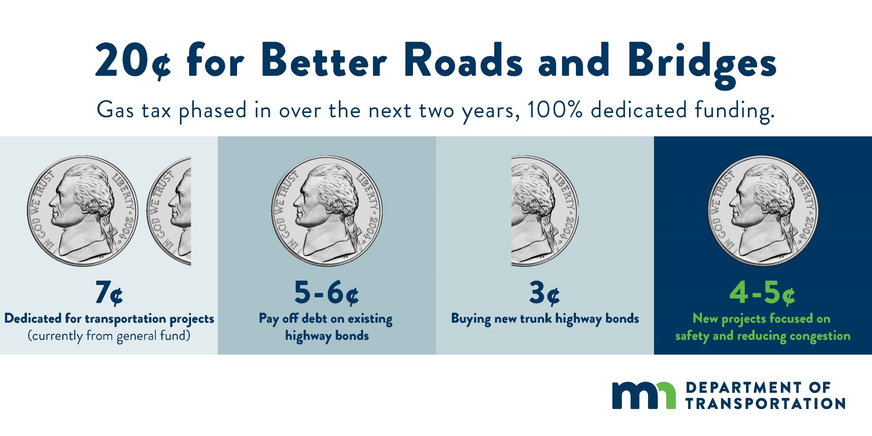
100% Dedicated Funding

Slide 11
What is in the Price of Gas?
In 1988, more than 22% of what you paid at the pump was state tax
(Gas tax raised to 20 cents; average per-gallon price was 90 cents)
Today, less than 12% of what you pay at the pump is state tax
More than 75% of the cost at the pump pays for the crude oil, refining and distributing
If Minnesota’s gas tax had been indexed to inflation (CPI) in 1988, it would be approximately 43 cents today

Slide 12
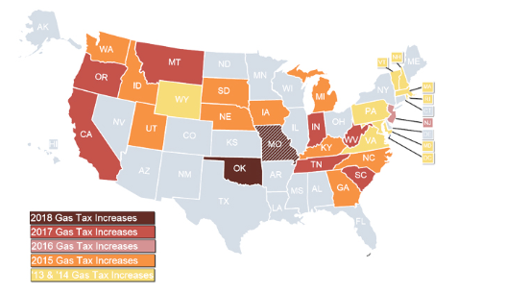
Motor Fuel Tax Rates
28 states and District of Columbia have raised their motor fuel tax since 2008
15 of the states had Republican governors and legislatures, 7 had divided government and 6 were led by Democratic governors and legislatures

Slide 13
Comprehensive and Dependable Transportation Plan
Registration Tax
Registration tax increase from 1.25% to 1.5%
Base tax fee from $10 to $45
Change in depreciation schedule
Amend base value calculation by removing destination charge and hold harmless provisions of statute

Slide 14
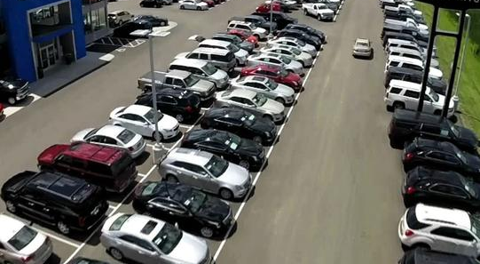
Comprehensive and Dependable Transportation Plan
Motor Vehicle Sales Tax
Increasing the motor vehicle sales tax from 6.5 percent to 6.875 percent
Effective December 1, 2019

Slide 15
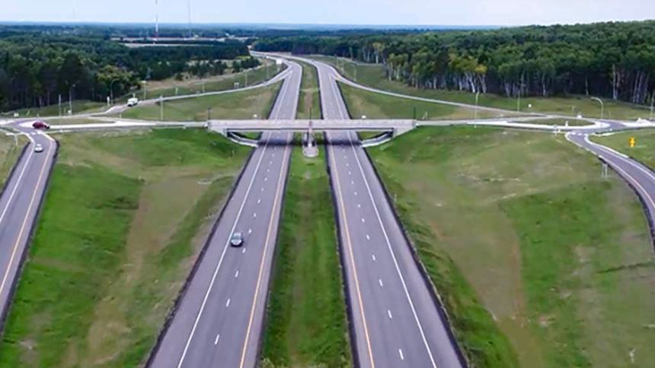
Comprehensive and Dependable Transportation Plan
Trunk Highway Bonds
Authorizes and pays for $2 billion trunk highway bonds over 8 years
  $250 million per year starting in FY 2022
  Debt service for these bonds is estimated to be $22.2 million for the FY22-23 biennium

Slide 16
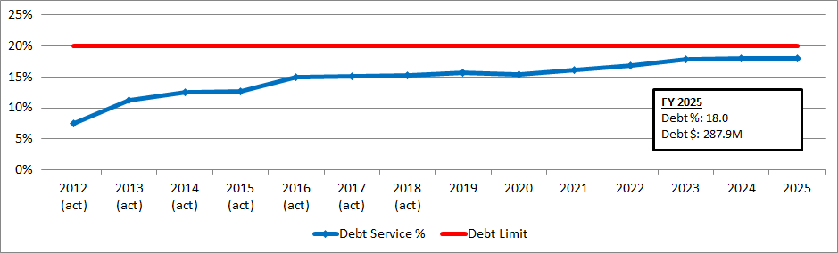
Debt Policy Limit
MnDOT’s internal policy states annual debt service costs cannot exceed 20% of annual state revenues and transfers in

Slide 17
Cumulative Debt Transfers vs. Trunk Highway Debt Service Surcharge

Slide 18
Comprehensive and Dependable Transportation Plan
*Based on November Forecast*
($1,000s) | FY 2020 | FY 2021 | FY 2022 | FY 2023
Gas Tax - Phased In (Over 2 Years) | 169,000 | 473,800 | 603,300 | 632,600
Registration Taxes | 209,500 | 426,800 | 430,000 | 430,800
Motor Vehicle Sales Tax (60% portion to HUTD) | 16,600 | 29,900 | 31,300 | 32,700
General Fund Transfers Reduction | (208,044) | (210,844) | (213,544) | (216,244)
Total, HUTD Fund | 187,056 | 719,656 | 851,056 | 879,856
Trunk Highway | 107,680 | 416,879 | 492,361 | 508,891
County State Aid | 50,366 | 194,992 | 230,298 | 238,030
Municipal State Aid Streets | 15,631 | 60,515 | 71,472 | 73,871
5% Setaside (CSAH) | 9,141 | 35,389 | 41,796 | 43,200
Total Distributions | 182,818 | 707,774 | 835,927 | 863,992

Slide 19
Impact to Minnesotans
The gas tax increase would add less than one penny to the total cost of operating the average car per mile
(vs. current estimated cost of 58 cents/mile per IRS)
Poor roads currently cost Minnesota drivers over $1,000 a year:
  Increased wear and tear
  Lost time due to congestion
  Increase in gas consumption
Drivers would pay an additional $185-298 per year (without accounting for costs above)
Impact to Minnesota drivers under funding package scenario (assumes $30k vehicle):
Cost to Driver | Current State | Funding Package Drivers pay an additional
Gas Tax | $214 annually ($0.59 a day) | $150 annually ($0.41 a day)
Registration Tax (1st yr.) | $385 ($1.05 a day) | $110 ($0.30 a day)
Registration Tax (5th yr.) | $235 ($0.64 a day) | $148 ($0.40 a day)
Registration Tax (11th+ yrs.) | $35 ($0.10 a day) | $35 ($0.10 a day)
Notes:
Approximately $350 in annual maintenance costs (US PIRG)
Travel delays due to congestion cost Twin Cities metro drivers $1,035 a year (Texas A&M Transportation Institute)

Slide 20

Working Family Credit
To help lower- and middle-income Minnesotans pay for transportation investments, the governor proposes an increase to the Working Family Credit
  $100 for each single or head of household recipient
  $200 for each married filing jointly recipient

Slide 21
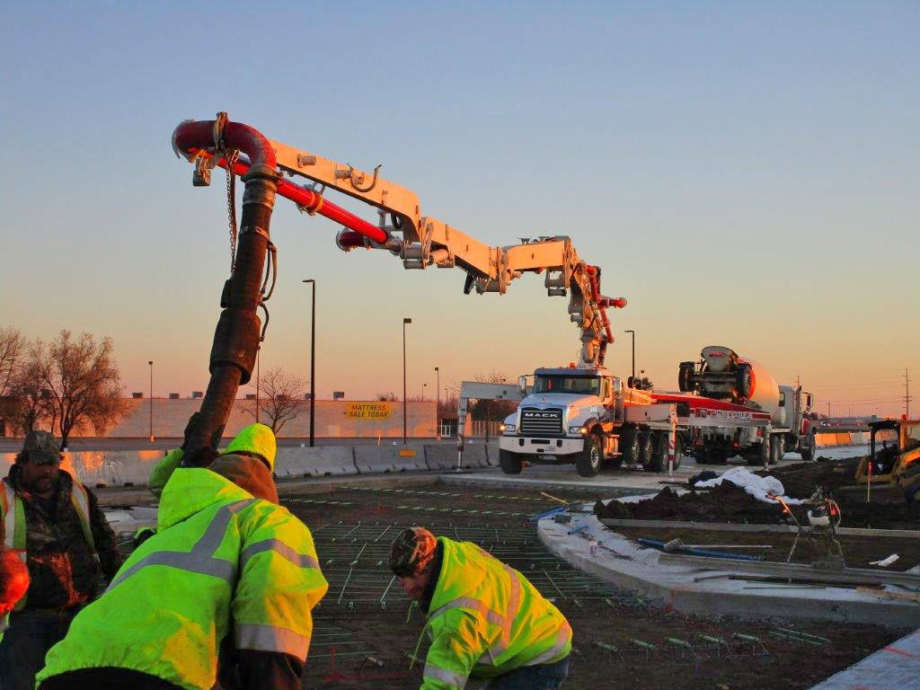
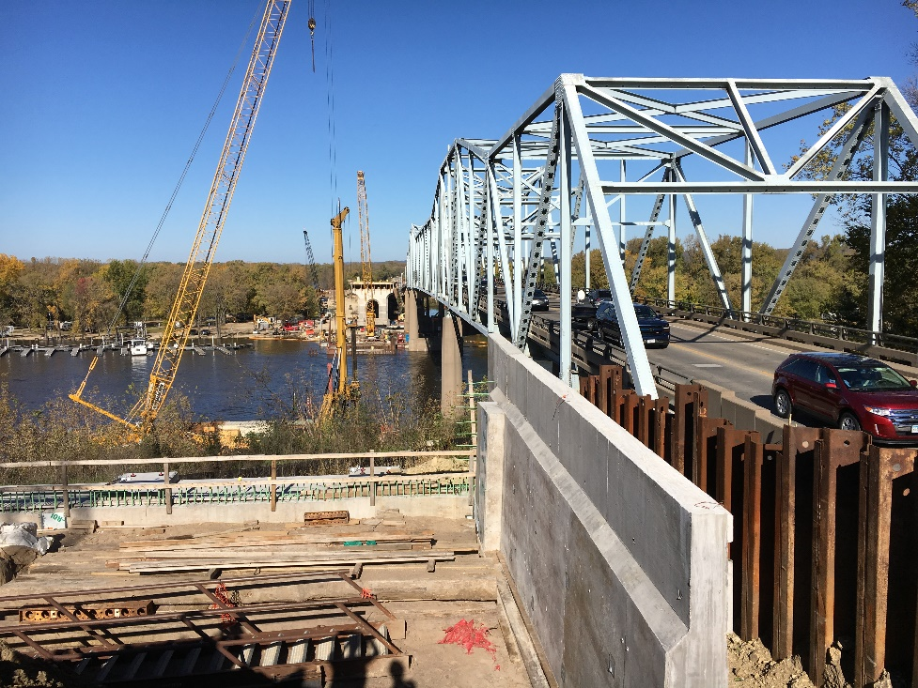
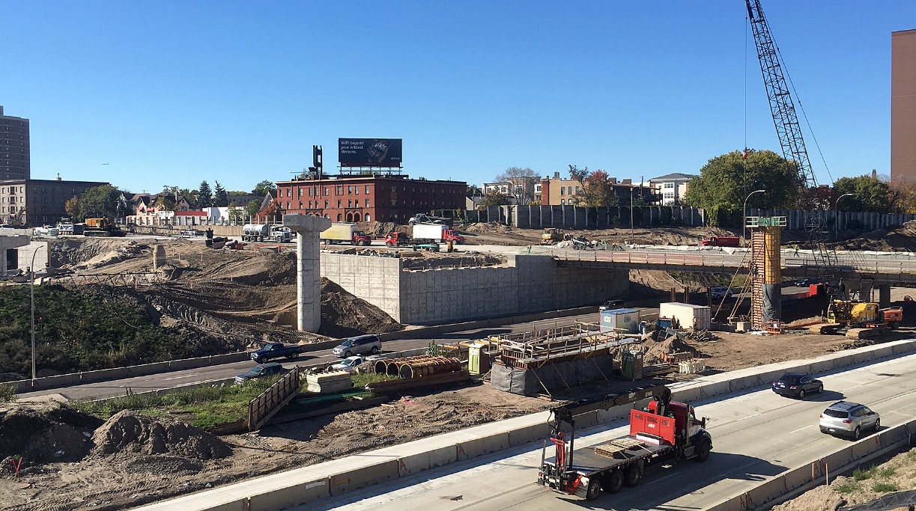
Funding the Future of Transportation Across Minnesota

Slide 22
Thank you!
More information:
www.dot.state.mn.us/transportationfunding

