Slide 1
Commercial Nuclear Power Safety
Minnesota Legislative Energy Commission
March 25, 2009
Tony Buhl, PhD, PE
President and CEO
EnergXLLC.COM
EnergXHanford.com

Slide 2
Nuclear Power Industry Experience
25 years in regulatory management
30 readiness verifications on large scale nuclear operations
Startup Review Board at Texas Utilities (Two 1100 Mw units)
TMI-2 USNRC Response Team
U.S. Nuclear Industry Program Manager for the Industry Degraded Core Rulemaking
Chernobyl-4 U. S. Nuclear Industry Response Team
Crystal River INPO Emergency Response Team
Fellow of the American Nuclear Society (elected for safety and risk management contributions)
Currently processing and shipping Highly Radioactive Nuclear Waste for permanent disposal ( NV & NM)

Slide 3
Is Nuclear Power Safe?
Industry Overview
Stakeholders transparency and direct involvement
Track record demonstrates Safety & Performance
Industry Safety Culture
New designs and operation processes include lessons learned from past and reduced risk for workers and public
Regulatory process has improved dramatically

Slide 4
Industry Overview
30 years since Three Mile Island Accident March 1979
23 years since Chernobyl-4 accident in the Soviet Union April 1986
Extensive Regulatory, Operations, Procedures and Training Changes as well as plant upgrades to include extensive Instrumentation and Control
Safety Culture Changes
INPO
WANO
Changes from “NRC Catch me if you can” to Continuous Improvement , Self Assessments, Performance Indicators and Self Regulation

Slide 5
Stakeholders
Nuclear power is the safest option for large base load electric power.
Believing this is an experiential process requiring TRUST and active stakeholder involvement.
TRUST: Firm reliance in the honesty, dependability, strength, or character of someone or something.
“To earn TRUST you must offer trust.”

Slide 6
Trust
“Firm reliance in the honesty, dependability, strength, or character of someone or something. One in which faith or confidence is placed”. (Webster’s II: New Riverside Dictionary)
Industry and Regulators were not there in 1979.

Slide 7
Building Trust
Paradoxically, trust is an attribute that is built in another by extending trust to the other person first.
“To earn trust, you must offer trust.”
In behavior terms, trust is consistency and predictability.

Slide 8
Building Trust (continued)
Trust is required in safety cultures, in high performance organizations, and in successful relationships.
It is required for the free flow of information about safety and performance, and for alignment of persons in organizations around goals and objectives. Continuous improvement requires honest, candid feedback, and this, in turn, requires trust.

Slide 9
Track Record
Only two significant accidents in 50 year history of civilian nuclear power generation worldwide, 12,700 cumulative reactor years of operation
Average number of significant reactor events over the past 20 years has dropped to nearly zero
Average number of times safety systems have had to be activated is about one-tenth of number 22 years ago
Average number of unplanned reactor shutdowns has decreased ten-fold (530 shutdowns in 1985, 2 in 2007)

Slide 10
U.S. Industrial Safety Accident Rate 2007
ISAR = Number of accidents resulting in lost work, restricted work, or fatalities per 200,000 worker hours. Electric utilities and manufacturing do not include fatality data.
Sources: Nuclear (World Association of Nuclear Operators), 2006 Data for Electric Utilities and Manufacturing (U.S. Bureau of Labor Statistics).
Updated: 4/08

Slide 11
Significant Events at U.S. Nuclear Plants: Annual Industry Average, Fiscal Year 1988-2006
Source: NRC Information Digest, 1988 is the earliest year data is available.
Updated: 11/07

Slide 12
Industry Safety Culture
Safety Culture is “that set of behaviors, beliefs, attitudes and assumptions that demonstrate an intentional and overriding priority on safety in everything an organization does.” (James Reason)
A safety culture is a reflection of the values shared throughout an organization a based on the belief that safety is very important and everyone’s responsibility. (Nuclear Regulatory Commission)

Slide 13
Safety Culture (continued)
The key words in these definitions are “shared”, “safety in everything”, “everyone’s responsibility”, “intentional”, and “overriding”.
Thus, a working definition might be:
“The overwhelming majority of people in an organization share the concepts that:
all tasks can be performed safely,
everyone desires to perform them safely, and
all members of the organization are equally responsible to perform work safely.”

Slide 14
Basic safety philosophy
Every incident can be avoided.
No job is worth getting hurt for.
Every job will be done safely.
Incidents can be managed.
Most importantly safety is everyone’s responsibility

Slide 15
Key safety principles
Working safely is a condition of employment
Each employee is expected to give consideration to the prevention of injury to self and to coworkers.
Involvement and thinking of all people in the safety process is valued and expected.
Continuous improvement is the goal.
Individuals and teams must be recognized for their adherence to and advancement of safety.

Slide 16
Nuclear Power Industry has Incorporated Numerous Safety Improvements
Redundant safety equipment
Containment buildings
Licensing and training requirements
Physical security
Remote sites, with emergency plans
Highly developed and evolving regulations
Not all present in other technologies

Slide 17
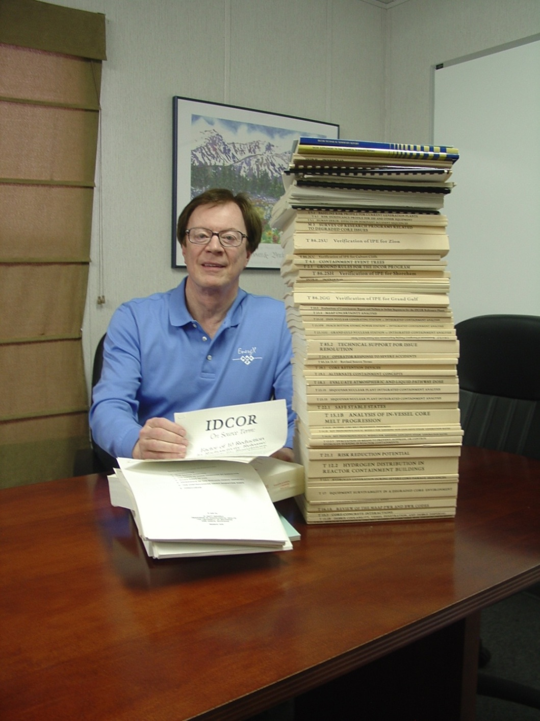
IDCOR
Comprehensive Nuclear Power Safety Evaluation
100 scientists and engineers for 4 years
23 Contractors
63 sponsors including 8 countries
Purpose - Resolve all severe accident issues and serve as industry spokesman with the USNRC
- Eight plant designs were completely evaluated.

Slide 18
Self Regulations Institute Of Nuclear Power Operations
All US energy companies that own and operate nuclear power plants are members
Focus on operational excellence, open communications, and continuous improvement
Formed National Academy for Nuclear Training
Provides inspections and assessments of plant performance and effectiveness of management

Slide 19
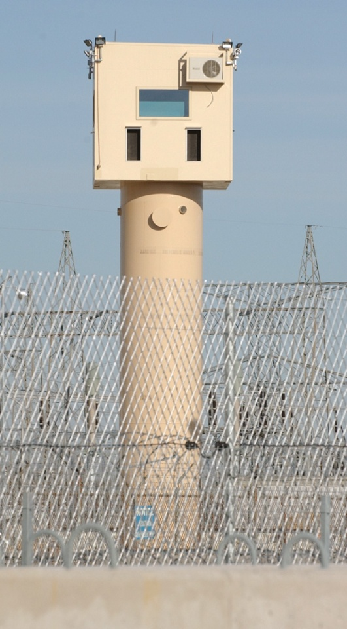
Nuclear Plants: A Model for Industrial Security
Industry moved aggressively to meet post-9/11 environment:
$2.1 billion investment since 9/11
Extended, strengthened security perimeters
Increased security forces by 60% to 8,000 officers; 9,500 by end of 2009
Closely coordinated with DHS, NRC, other government agencies
New security tower at the Clinton nuclear plant

Slide 20
Addressing proliferation concerns
Physical solutions
- Continue current barriers (guns, gates, & guards)
-Reduce inventory of weapons-grade material by fission in power reactors
Political solutions (proposed by GNEP)
- Prohibit reprocessing facilities in additional countries
- Prohibit enrichment facilities in additional countries
- Establish centralized world-oversight of all weapons- grade material

Slide 21
CONCLUSIONS
At least for the next few decades, there are only a few realistic options of reducing carbon dioxide emissions from electricity generation
Increase efficiency in electricity generation and use;
Expand use of renewable energy sources such as wind, solar, biomass, and geothermal;
Capture carbon dioxide emissions at fossil-fueled (especially coal) electric generating plants and permanently sequester the carbon; and
Increase use of nuclear power.

Slide 22
“The future of this country is dark without nuclear power.”
Rep. John Dingell (D-Mich.)
Richmond Times Dispatch
April 9, 2008

